Slide 1
Rapid Deployment STANDING TEAM (RDST)
OCTOBER 2019

Slide 3
RDM & RDST
ICRC Surge
ICRC RD Capacities
RD Standing Team
RD Response Team(s)
NS RD Capacities
RD Response Team(s)
Movement Surge

Slide 4
RDST: 4W
Assistance: 1 Wathab Coordinator, 1 Ecosec Coordinator, 1 Health Coordinator
1 Protection Coordinator
Support services: 1 HR Manager, 1 Logistic Coordinator, 1 F & A Manager, 1 ICT Manager (to be recruited)
1 NS Capacities Coordinator, in charge of liaising with the NS contributing to the ICRC surge
- 1 RDST Manager / Team Leader (Red line)
What:
Permanent Human Resources capacity foreseen within the Rapid Deployment Mechanism (RDM)
Why:
To respond to humanitarian crises in a timely manner, by deploying experienced staff in a very short delay (24-48 hours)
Who:
Main functions required in the initial phases of the response
Doing What:
[Crisis Response] Assess the situation and mobilization needs; define the additional support required; run and stabilize the response; Phase out
Other uses: Crisis support, Staffing gaps, support to HQ units

Slide 5
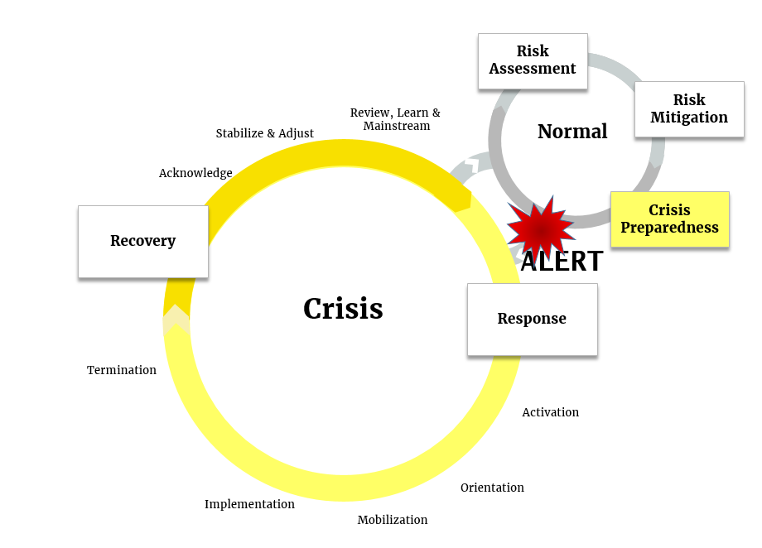
RDST & Crisis Management
Crisis support - Preparedness
assess the situation and mobilization needs
Phase out
Define the additional support required
Run and stabilize the response

