Slide 1
WASH and Cholera
Preparedness to Response-
WASH Advisor Meeting
Geneva 2017

Slide 2
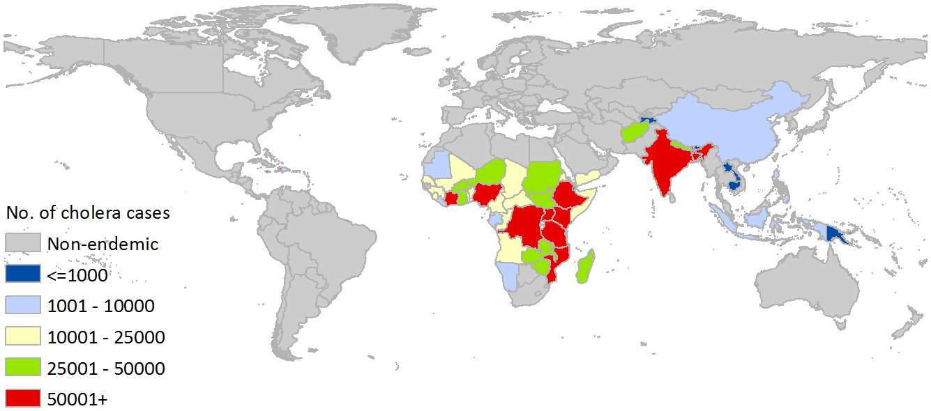
Global Cholera Burden
Updated Global Burden of Cholera in Endemic Counters Ali etl
There are an estimated 2.86 million cases of cholera annually in endemic countries. Spatial distribution of the burden of cholera in endemic countries are shown in Countries with estimates of more than 100,000 cases annually include: India, Ethiopia, Nigeria, Haiti, the Democratic Republic of the Congo, Tanzania, Kenya, and Bangladesh
The average incidence rate in endemic countries is 2.30 cases/1,000 population at risk per year
Cholera resulted in approximately 95,000 deaths annually in endemic countries. This translates to approximately 7.50 deaths/100,000 population at risk per year in endemic

Slide 3
Trend in cases reported by year and continent 1989 - 2014

Slide 4
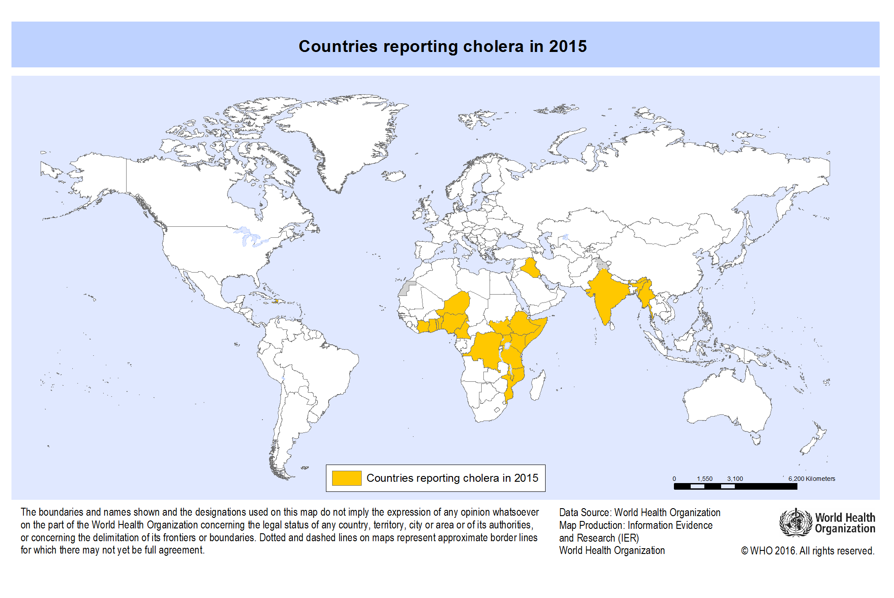
Countries Reporting Cholera in 2015

Slide 5
Worldwide Distribution of Cholera in 2015, by Country*

Slide 6
Endemic vs Epidemic
New models suggest cholera dynamics are much more complex than it was previously thought
Most studies associating cholera dynamics to environmental events are based on correlations. The causal mechanisms behind these correlations are still poorly understood.
In some cholera endemic regions, outbreaks are periodic with one or two peaks per year.
Seasonal floods and droughts cause periodic variations in contact and contamination rates. If such variations are strong enough to cause large variations of R₀, we will note the occurrence of periodic outbreaks. Cholera outbreaks will be triggered when contact and/or contamination rates bring the R₀ above the unity threshold
Endemic cholera, however, can be maintained even in the absence of a permanent reservoir.
http://bmcinfectdis.biomedcentral.com/articles/10.1186/1471-2334-1-1

Slide 7
Cholera in context
Flooding and drought are likely to affect cholera dynamics in a complex way.
In endemic regions, cholera outbreaks are often associated to climatic events .
In some parts of Africa, outbreaks occur during the dry season or right after heavy rainfalls.
In the Americas, disasters caused by the El Niño preceded large cholera outbreaks.
In Bangladesh, cholera season coincides with the post-monsoon period.
Seasonal variations of water temperature has been also associated to cholera outbreaks.

Slide 8
The right response for the right context
Move away from copy paste cholera response:-
Prevention, control and Response
  Know your context
  Know your disease dynamics
    Endemic vs epidemic
    Seasonality
    Hot spots
    Transmission routes
  Design for root cause control of transmission

Slide 9
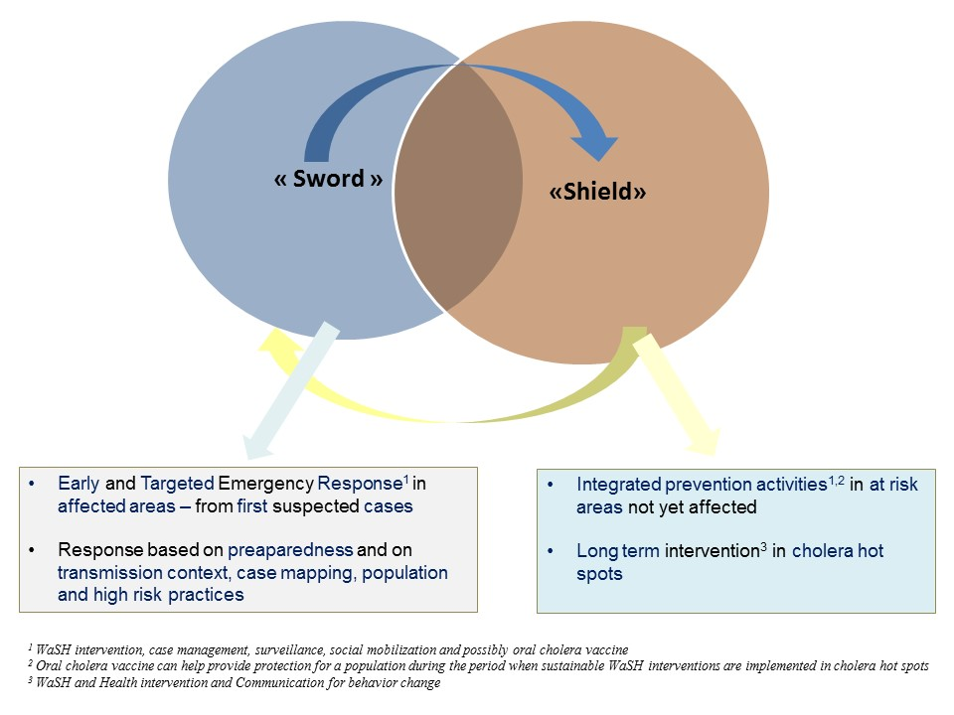
Sword and Shield Response – linking with the Epidemiology

Slide 10
Approaches to Cholera Control
The long-term solution for cholera control remains increasing access to safe drinking water, hygiene and improved sanitation infrastructures.
OCV has proven effective in reactive campaign in Africa.
OCV has recently been shown to have a protective efficacy for at least 5 years. This opens the possibility for preventive use of OCV in locations that are historically at high risk of cholera, especially in sites with low access to care and where it is not feasible to improve health and sanitation conditions in the short term.
OCV can serve as a short- and medium-term step in controlling cholera while longer term solutions are put in place or where such solutions are difficult to put in place,
https://www.ncbi.nlm.nih.gov/pmc/articles/PMC5301166/

Slide 11
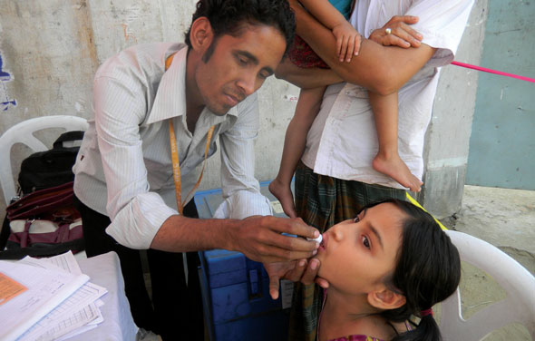
The role of Oral Cholera Vaccine
Moving to one dose stratergy in some contexts
Increasing supply
Large investment in vaccinating ‘hotspots’
Emergency stockpile remains available at 2 million does

Slide 12
Role of Social Science
Hygiene Promotion and Social Mobilisation
Need to move beyond 5 key messages –
Understanding at risk livelihood groups
Routes of transmission
Population Movement
Acceptability of OCV and other interventions
Rumour management

Slide 13
Role of Early Detection Early Action
Community Based Surivllance
  Early detection at community level ensures early control measures can be implemented
Community Based Treatment
  Oral Rehydration Points - community kits
Household Disinfection kits
  Targeted disinfection and not spraying
Household water treatment

