Slide 1
Emergency WASH Vienna January 2016

Slide 2
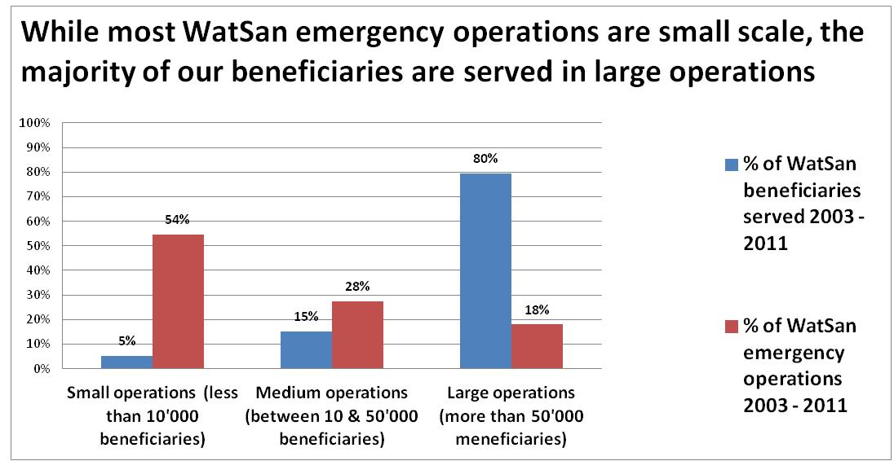

Slide 3
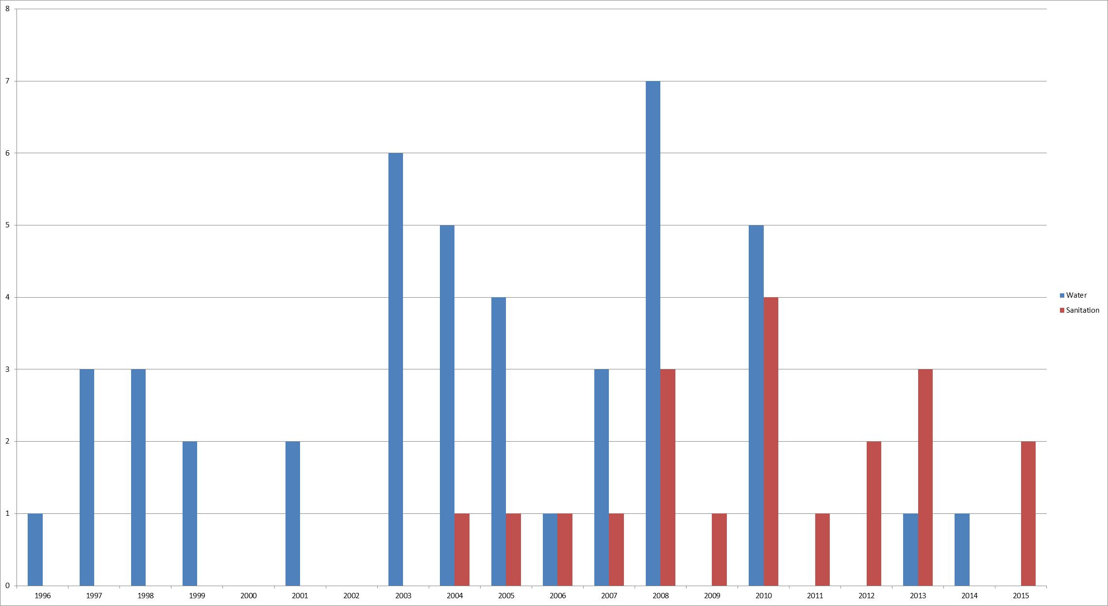
ERU Deployments 1996 - 2015

Slide 4
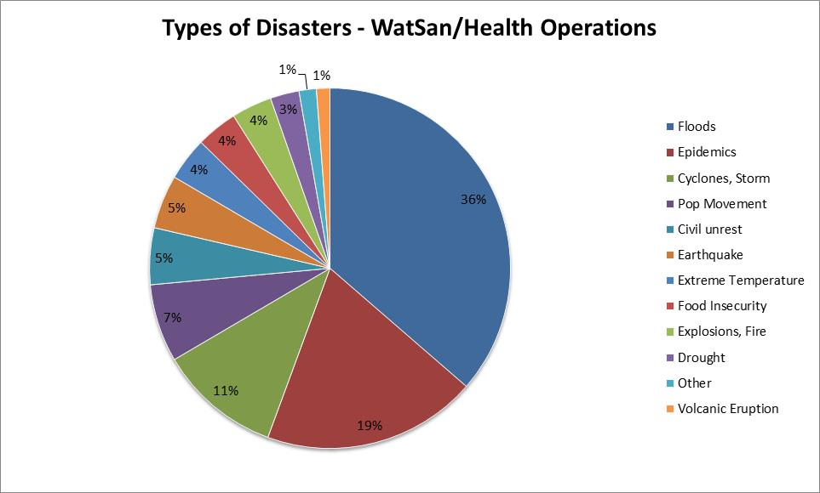

Slide 5
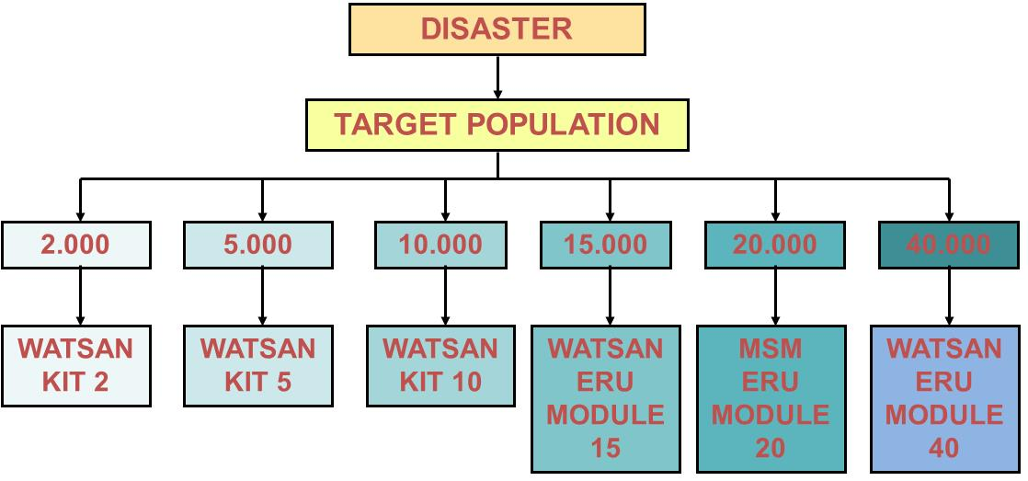

Slide 6
WASH Global Tools
DISASTER
TARGET POPULATION
2.000
5.000
X.000
X.000
15.000
20.000
40.000
WATSAN KIT 2
WATSAN KIT 5
RWSR
MODULE
X
HWTS
MODULE
X
WATSAN ERU MODULE 15
MSM ERU MODULE 20
WATSAN ERU MODULE 40

Slide 7
An interesting proposal
NS FACT On Call Rota
Still interested?
What can we put in place today?

