Slide 1

Project Progress Report

Slide 2

Why One Stop Shop
Water and Sanitation is important
2.6 billion people do not have access to your own toilet. 40% of the world's population.
1.0 billion are defecating in the open.
Every year, 2.4 million. Children dies from diarrhea
  1.4 million children die due to contact with faeces - (> AIDS malaria + TB)
  2,000 children die every day in Africa of diarrhea
The most effective investment in such areas is an investment in hygienic sanitation, which gives people access to toilet and bath. WHO have stated 1§ invested in sanitary solution will give the government a return of investment of 5§.

Slide 3
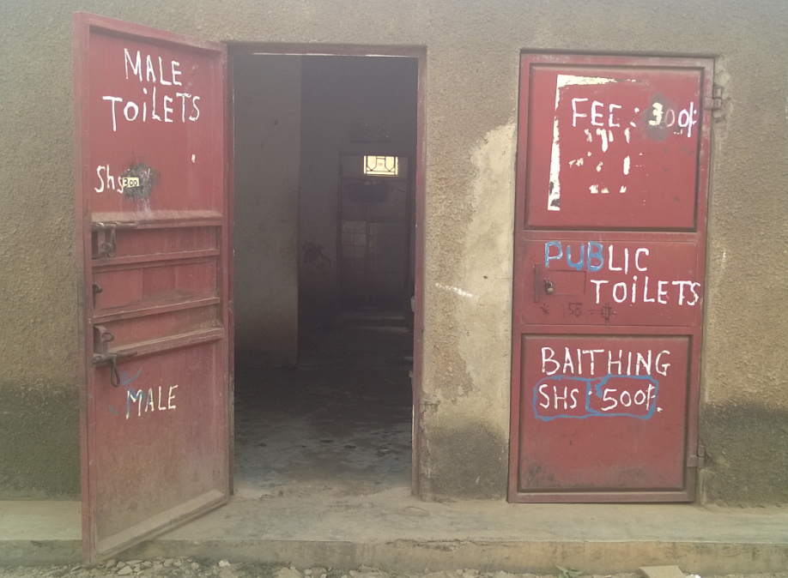
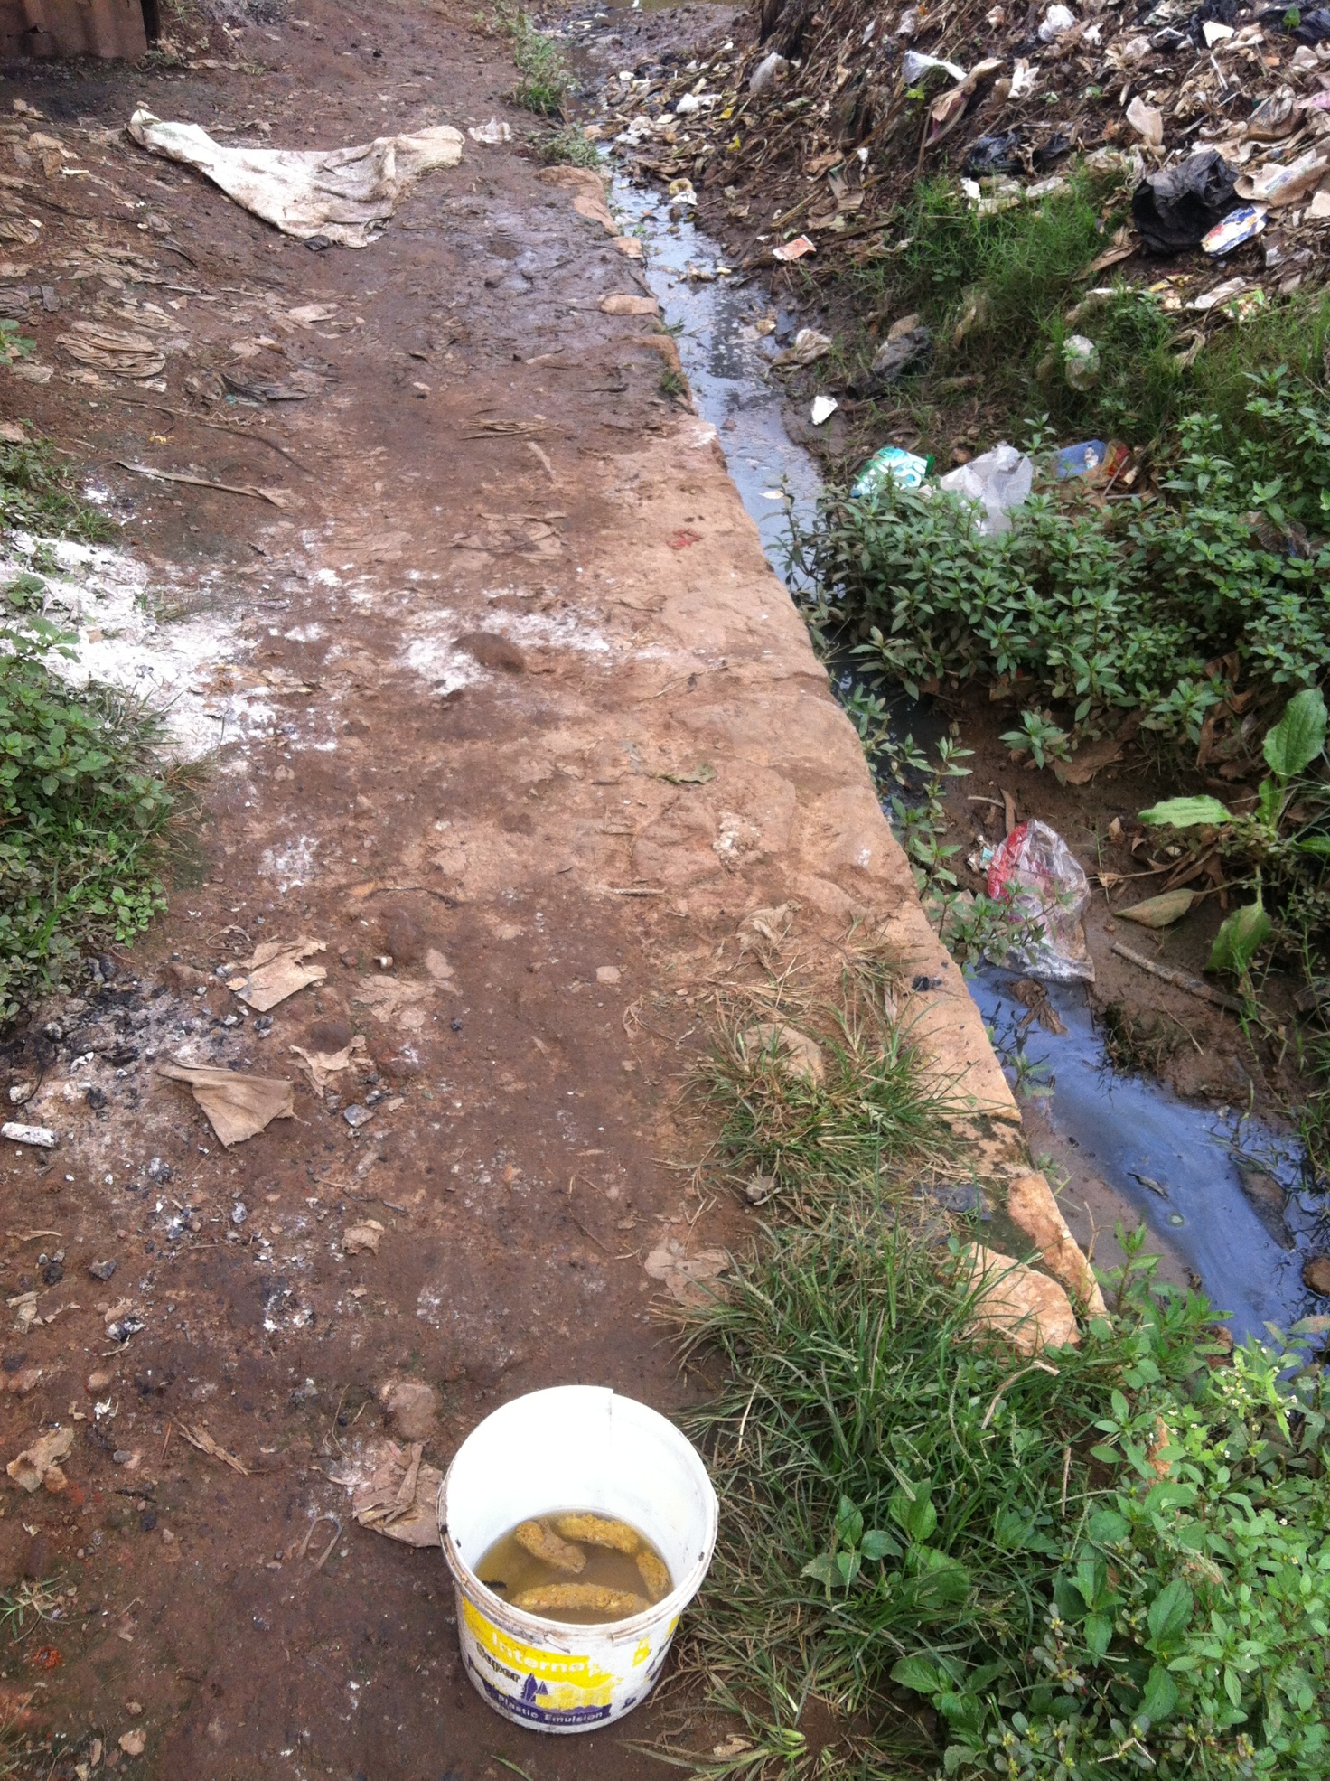
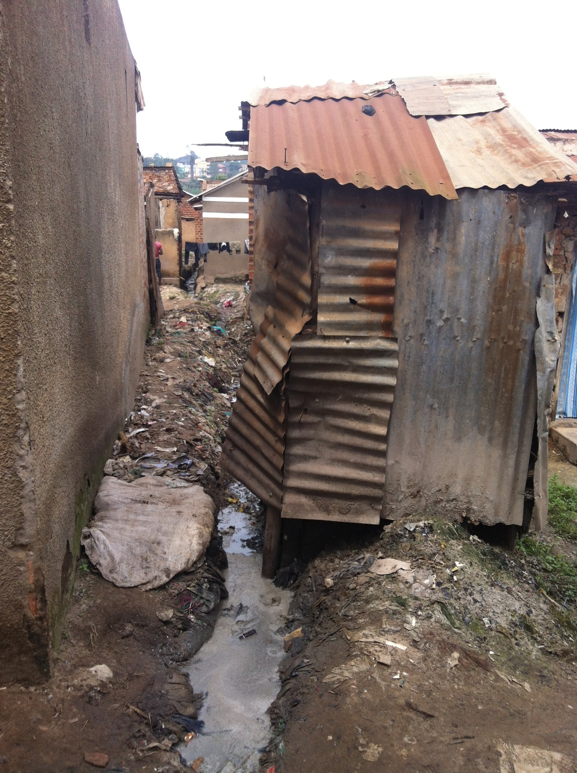
Water and Sanitation is good business for the government.
The most effective investment in such areas is an investment in hygienic sanitation, which gives people access to toilet and bath.
WHO have stated 1§ invested in sanitary solution will give the government a return of investment of 5§.

Slide 4

Project Partners
Cluster lead partner: EnviClean
Cluster Local Partner: Water Tech
Associated partner:
  DMS Africa and Red Cross
Cluster partner:
  AVV and Bigadan

Slide 5
Project Partners
The investorens

Slide 6

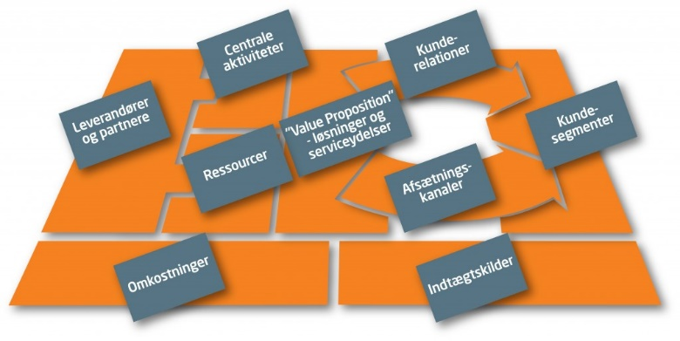
The One Stop Shop Business Model
ENVICLEAN
THE HORIZONTAL BUSINESS MODEL
PURPOSE: Ensure partnership sustainability
It is important that all partner knows his role
Expectations can only be redeemed if but his partner role proved
THE VERTICAL BUSINESS MODEL
PURPOSE: To ensure the business sustainability
Dividing the overall business model of self-sustaining process units
Step by step test of the individual (business) unit processes for sustainability

Slide 7
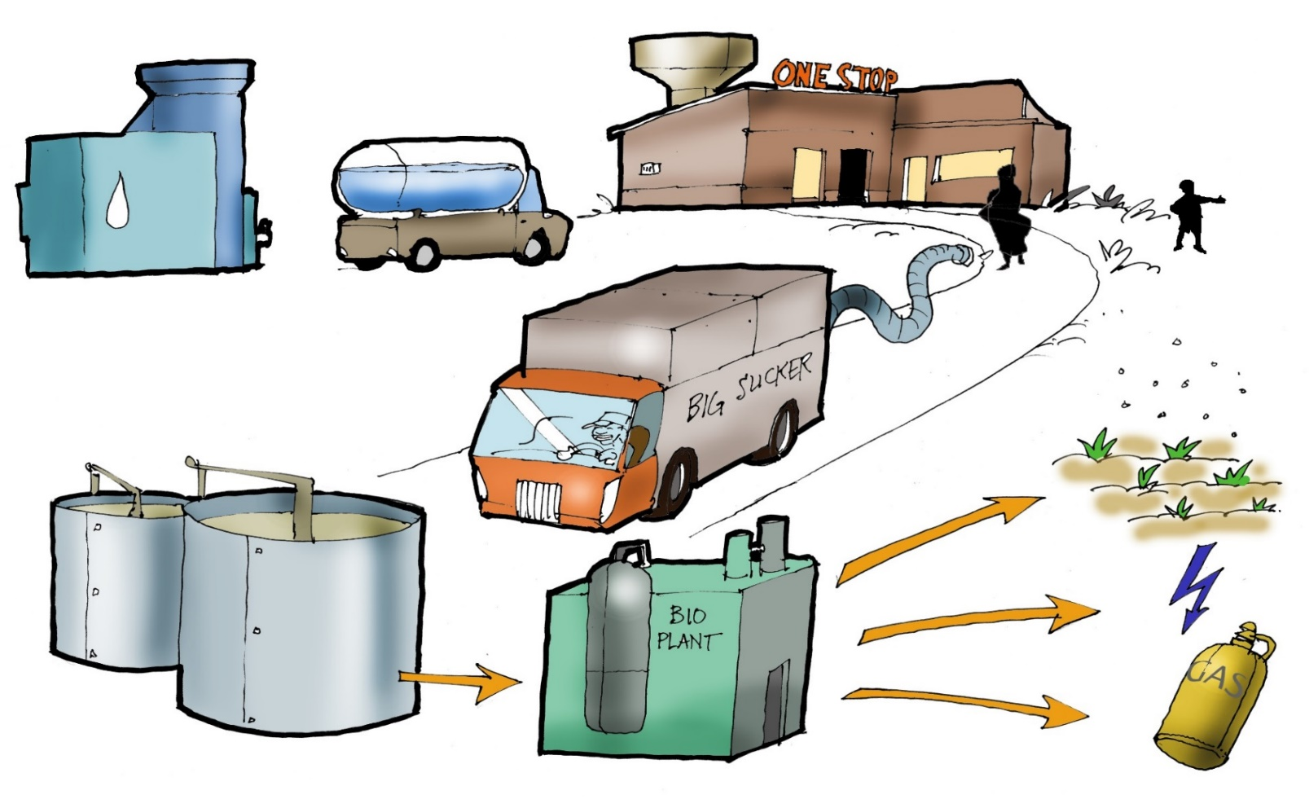
The One Stop Shop combined
Businessmodel
3 primary business models
3 secondary business models

Slide 8
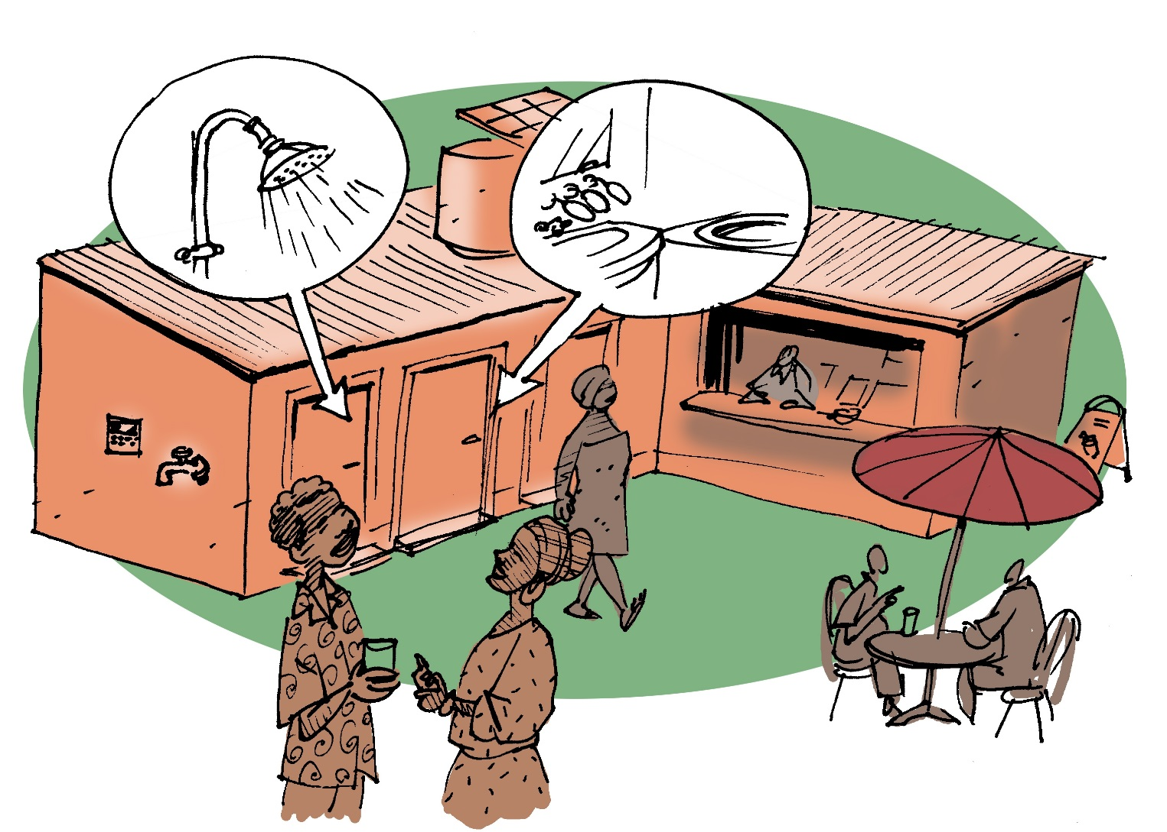
Proof of Concept
Toilet system including hygiene shop
Financial sustainability is spread over two activities that are connected together via a customer loyalty program.

Slide 9
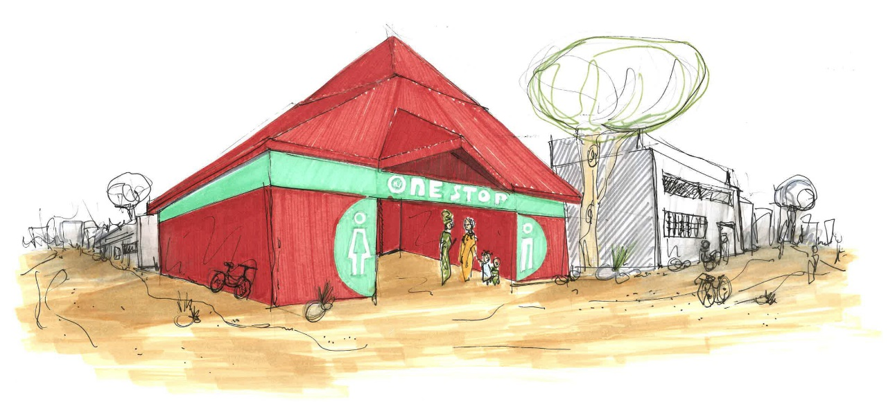
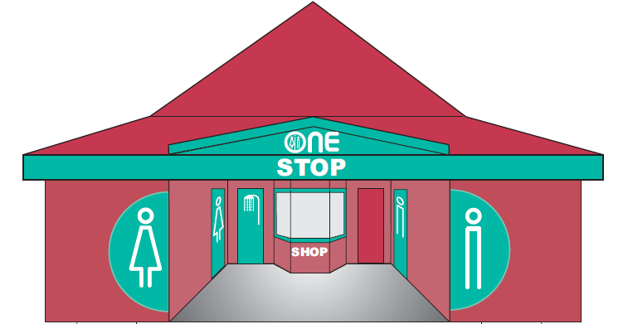
Proof of Concept
Timetable:
(Milestone)
Design: 2014: Jan - April
Building: 2014: April -Maj
Start up: 2014: 1. July-14

Slide 10
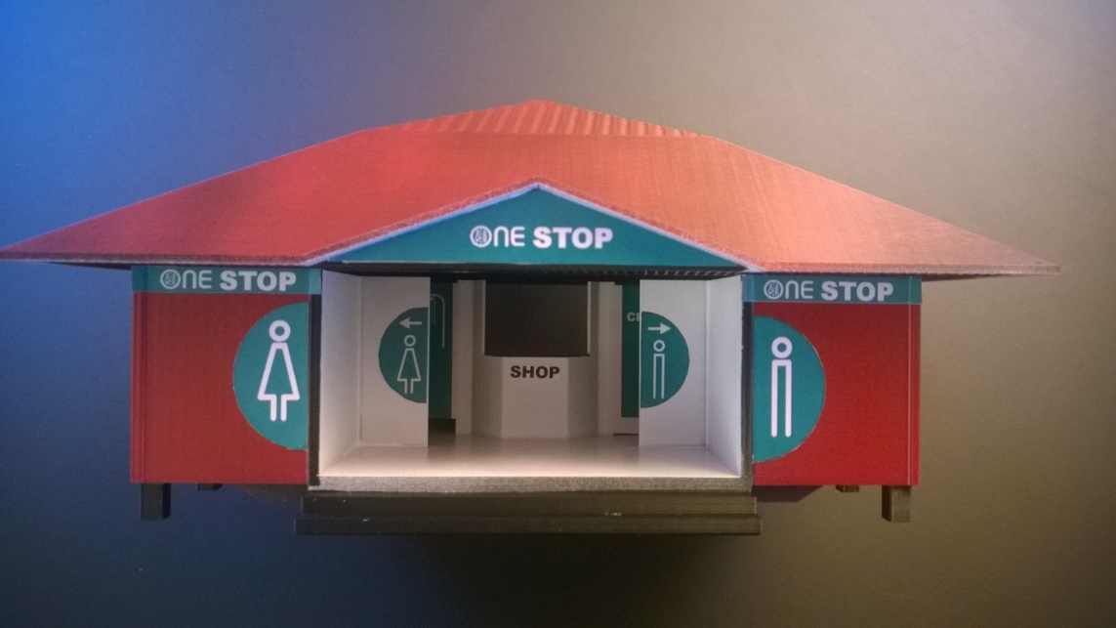
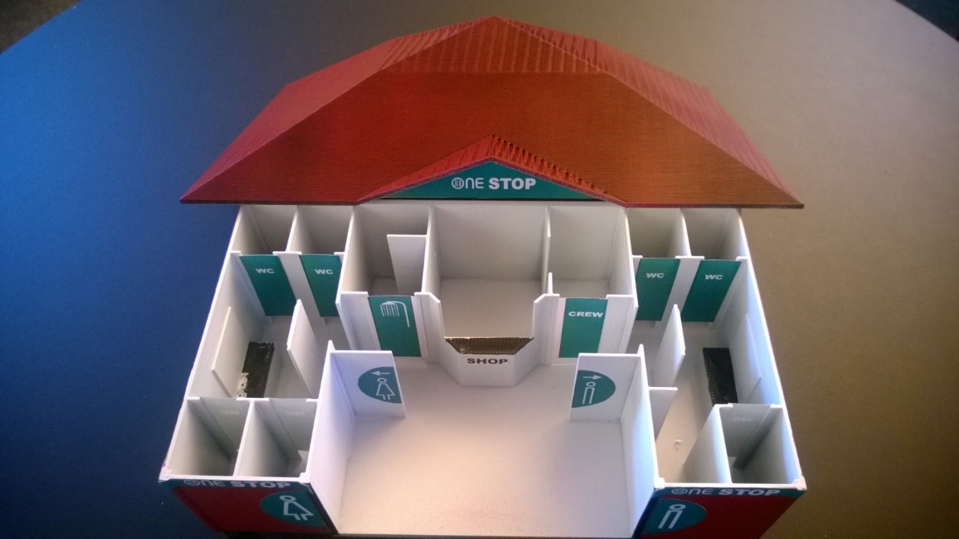
Design of the toilet building
The design of the One Stop Shop facility is build upon extended focus group interviews, usability test, and behavior analysis.

Slide 11

Design of the payment system
One of the major challenges was to design a payment system for BOP segment, so that the health risks of handling money, and koroption was minimized while users understand the concept of loyalty program.
The Partner Joint up with the
Company Pay-E-Safe, whom has developed the payment system to the One Stop Shop

Slide 12

Building period
May, June and July
The construction period presented many unforeseen problems, not least unforeseen costs that were necessary in order not to project fails.
There were customs problems which meant significant costs.
There were site preparation, which should have been done by the municipality, but became an One Stop Shops problem.
There was local flooding problems were also solved the One Stop Shop

Slide 13
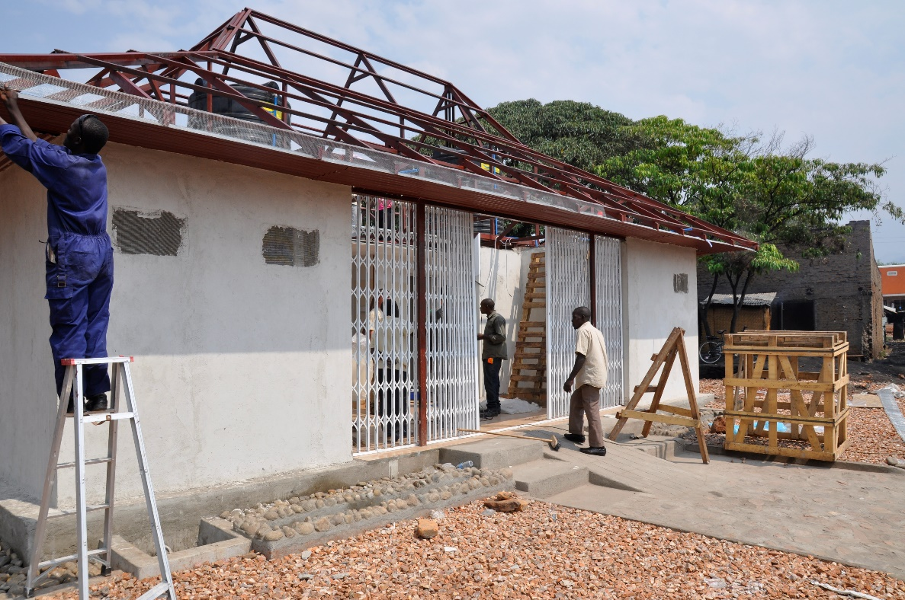

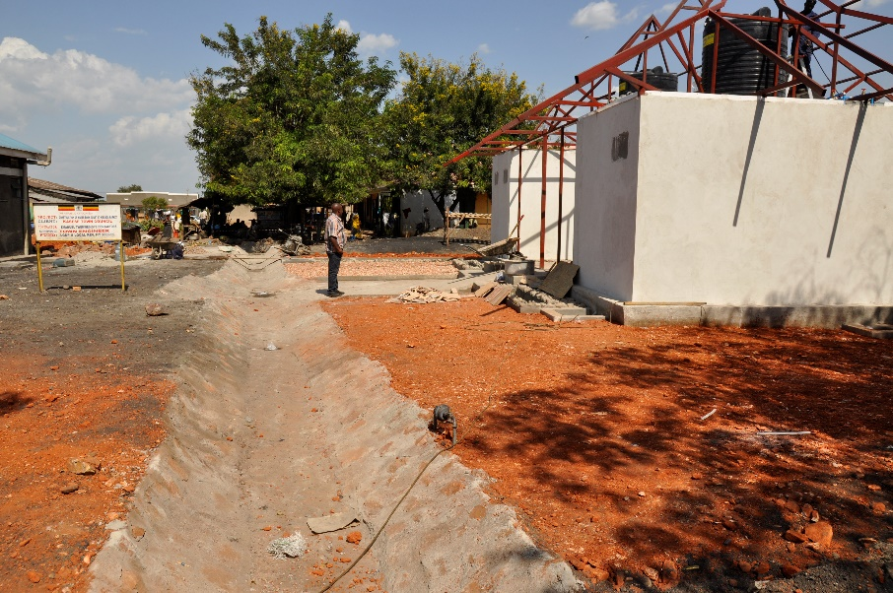
Building period

Slide 14
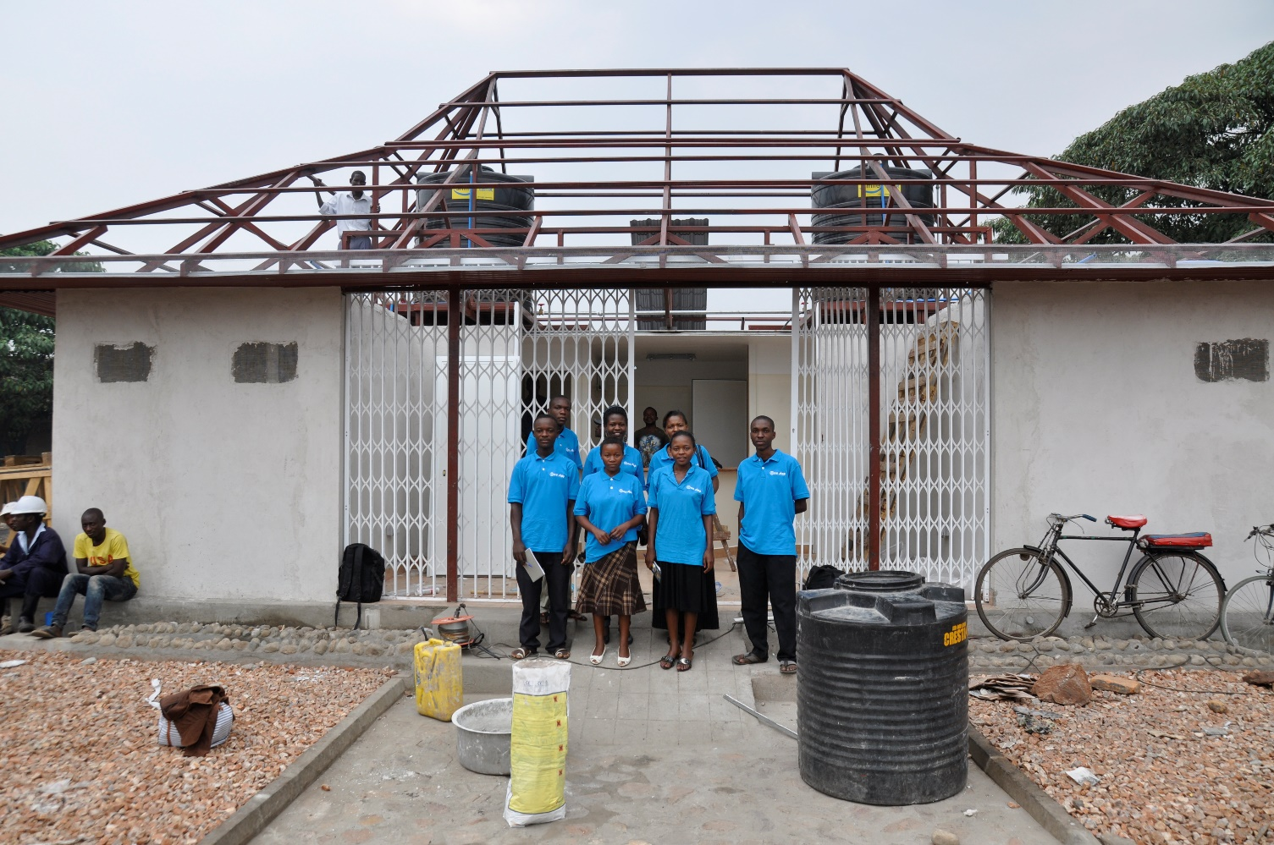
Building up the local team
Total 7 persons.
One of the important elements of the project was the building of the local staff.
Long before the opening, the local team was employed, in order to make a capacitive building.
First Aid
Hygiene
Basic Cleaning
Economy and Accounting
Ect.

Slide 15
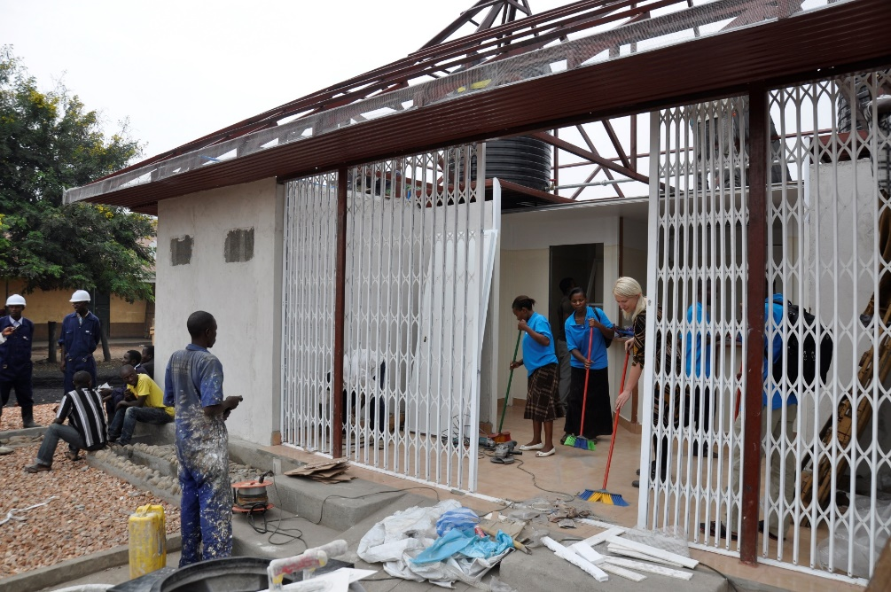
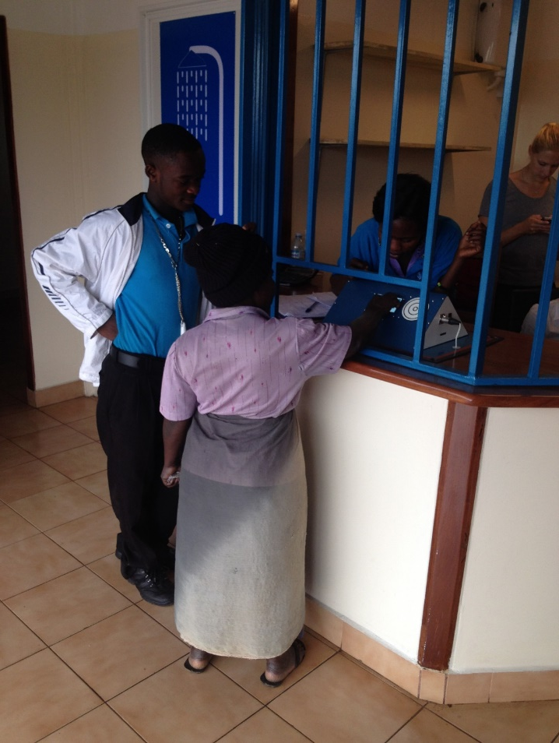
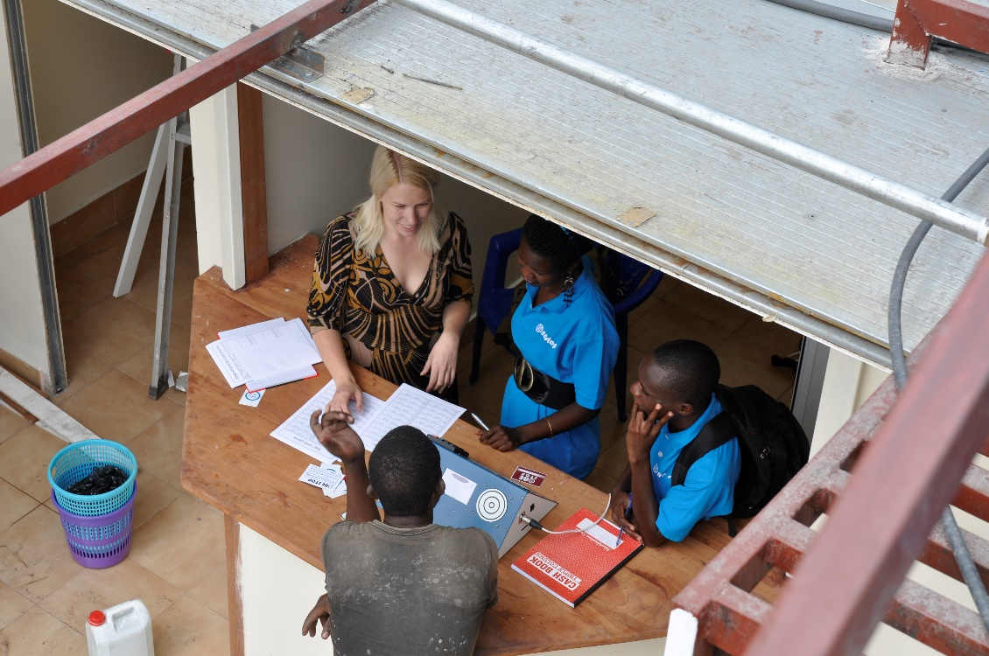
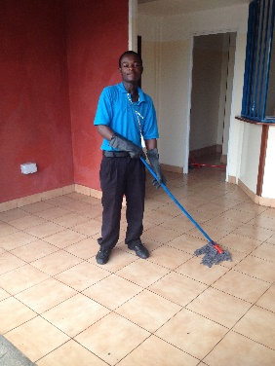
Building up the local team
Costum training
Economy and account training
Cleaning training

Slide 16
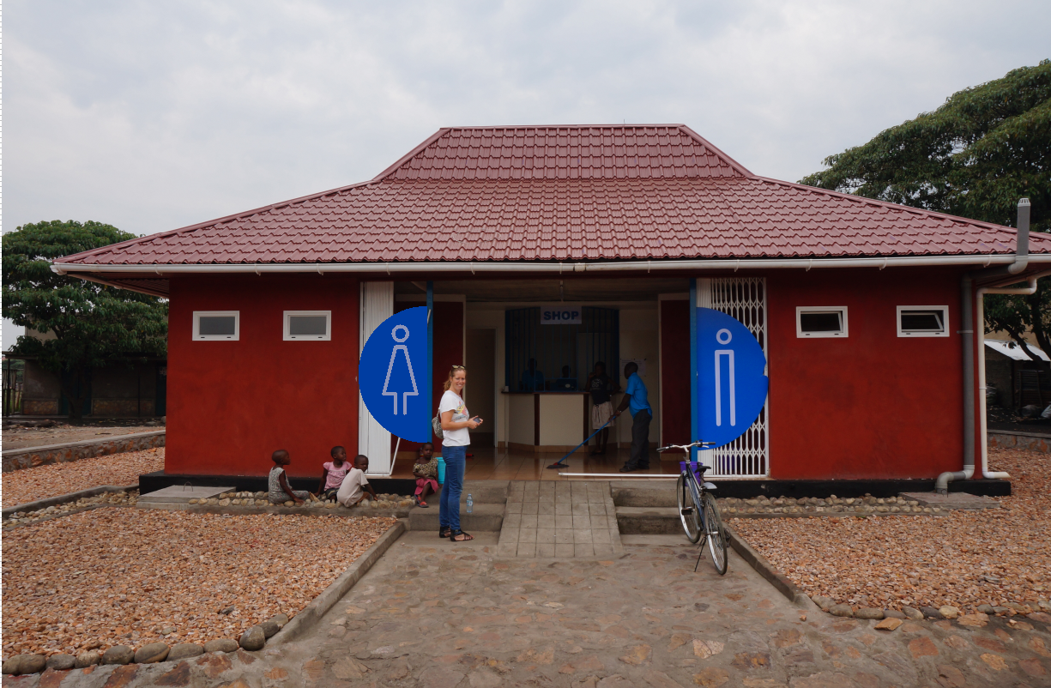
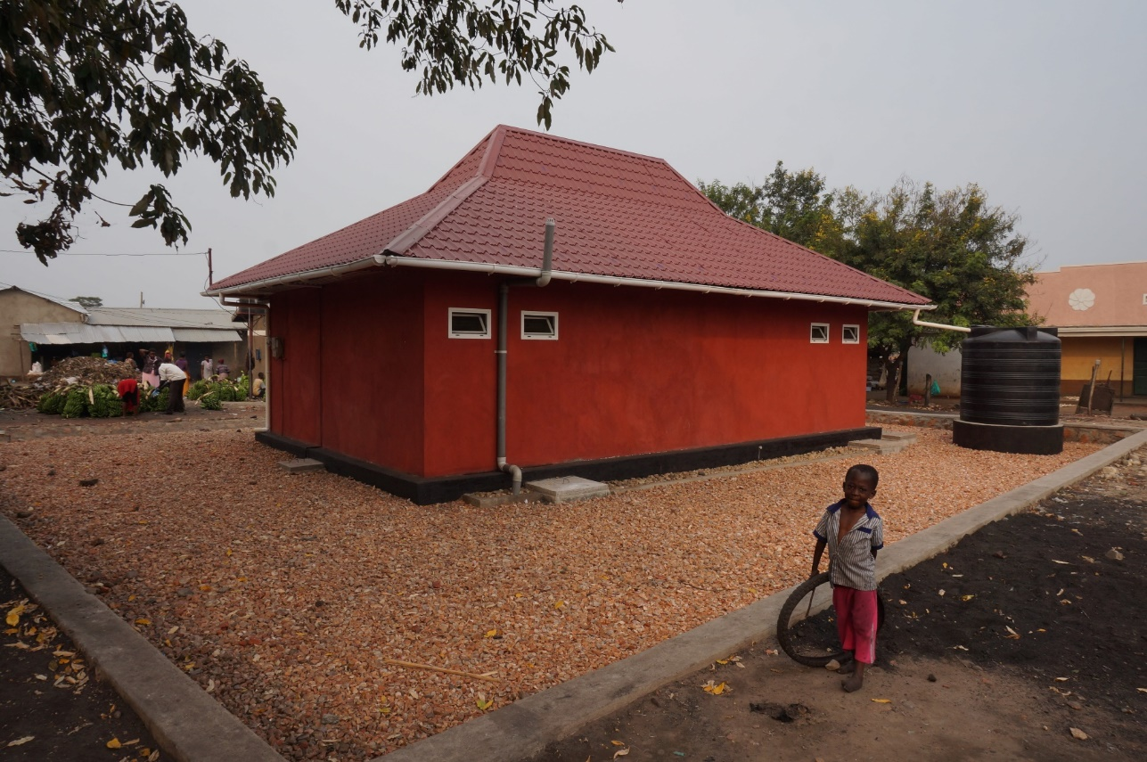
First opening for invited training: 15-07-2014
First public opening day: 22-07-2014

Slide 17
Results

Slide 18
Results

Slide 19
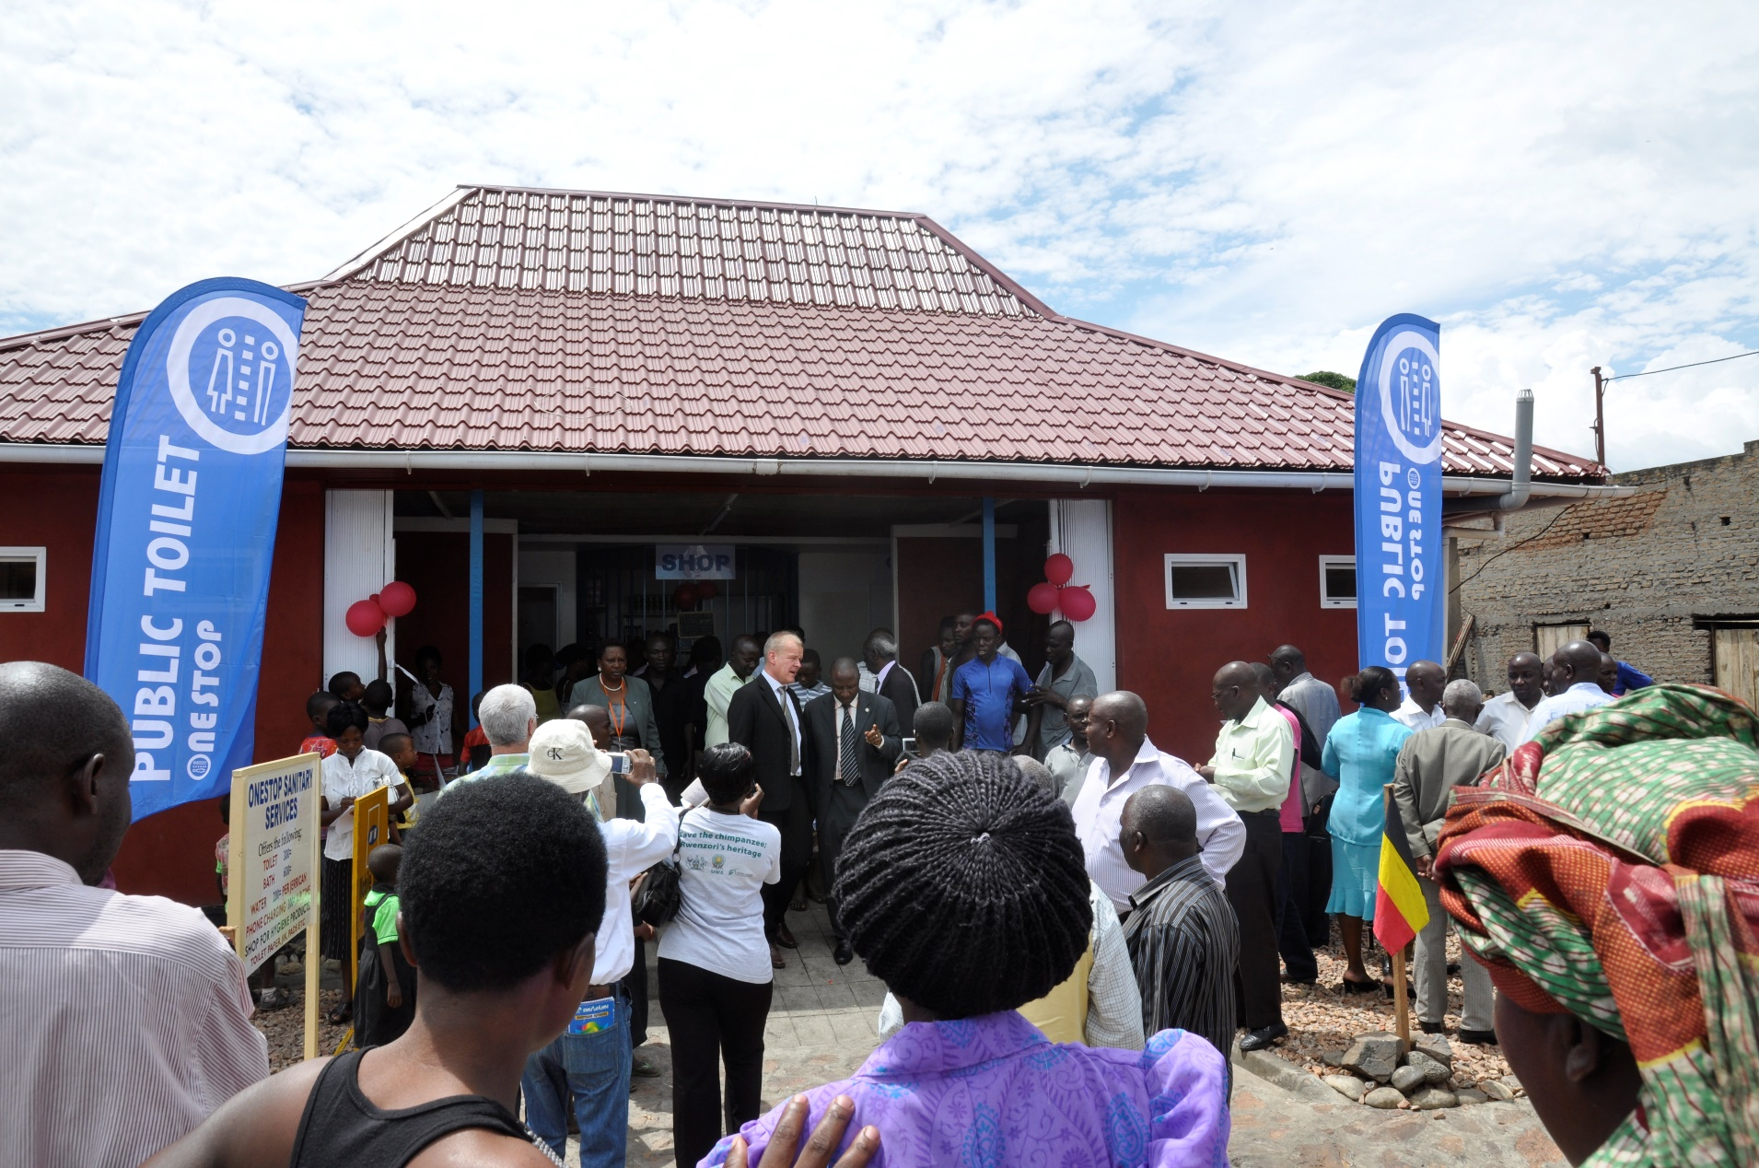
Grand Opening Day: 19-11-2014
(After 120 day in
operation)

Slide 20

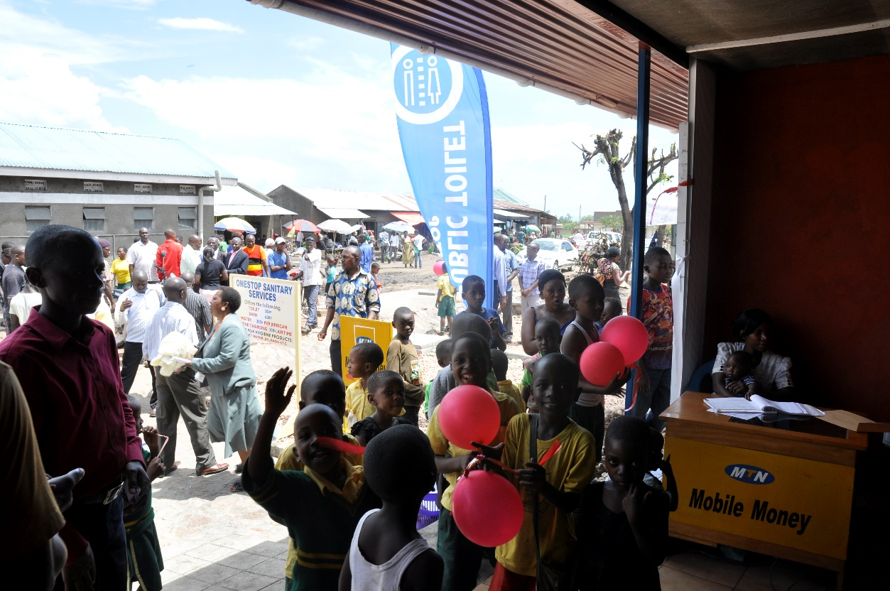
Grand Opening Day: 19-11-2014
(After 120 day in operation)

