Slide 1
Theme: Developmental WASH; Centralised systems, sustainability and impact, URBAN WASH. An Overview
Federation WASH
Stockholm World Water Week
PNS WASH Advisors Meeting

Slide 2
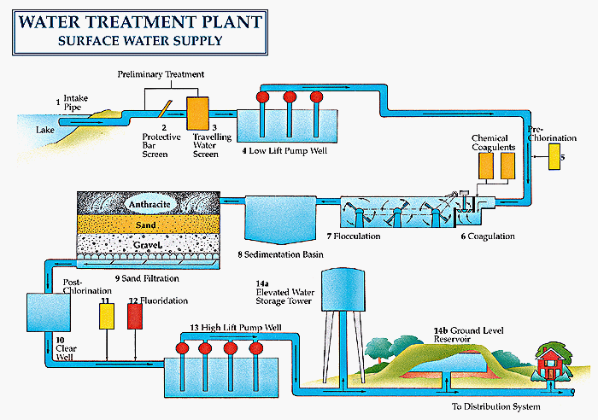
Developmental WASH: Centralised Systems/URBAN WASH, Sustainability and Impact.
Federation WASH
Observations:
GWSI primarily rural and mostly small scale (however to a high volume).
NS existing skill sets in WASH mostly still rural in nature
Some exceptions to that in East Timor, post Tsunami countries, Nepal, Kenya, Burundi, Rwanda, Uganda.
Exit strategies for centralised systems/URBAN WASH may be more complex.
Are we addressing sustainability and impact measurement well?

Slide 3
Developmental WASH: Needs & Challenges:
Federation WASH
Why should the RCRC engage? Both centralised systems and Urban WASH are areas we need to expand further, but what are the drivers to do so (e.g. cost effectiveness, scale, needs in peri-Urban and Urban, RC/RC positioning) and what is the value added of the RCRC?
What are the key issues and risks? Can we identify/define RC/RC role with private and public/private utilities, what is our advocacy role for ‘pro-poor’ Urban WASH? What are the other key issues for engagement?
What do we need to engage effectively? Are new skills required in engineering, finance (revenue), and management of centralised systems? Where can we access these skills? Is the ‘Look Back’ tool still valid for centralized /urban systems? What other evaluation methods/tools do we or might we use?
Discussion Points – Way Forward

Slide 4
Discussion points and Ways Forward:
Federation WASH

