Slide 1
Revision of IFRC Sustainable WASH Software Tools Introduction, Results, Key Challenges / Gaps
20th March 2017, Geneva
Community wisdom partners

Slide 2
This afternoon
Present consultancy
Present findings from work done to date
→ To get feedback and guide the way forward with revision of the “IFRC WASH software tools” publication and roll-out plan
Notes:
Technical Working Group was set up at beginning of consultancy, to provide input and feedback at all stages.
Originally was a virtual workshop – but it was agreed that a face-to-face 2 day workshop would be much more useful in getting feedback, inputs etc.
However, due to scheduling and timing issues this workshop was ‘merged’ together with other WASH meetings going on this week.

Slide 3
Terms of Reference
Specific objectives
Assess the needs for support in long-term HP programming & develop set of recommendations for capacity development
Produce draft revision of “The IFRCs software tools for long-term water and sanitation programming”
Develop a roll-out plan for the revised publication
Main output = Revision of the “IFRC software tools” publication, through a consultative process with RC/RC field practitioners
Notes:
Note: the terms ‘hygiene promotion’ and ‘software’ are used interchangeably in the TOR and by many RCRC staff/volunteers. Either term in this context is taken to mean all WASH related software (design, provision, use and maintenance of materials and facilities, community mobilisation, link between hygiene promoter and engineers/technicians, community engagement and participation).

Slide 4
Scope and timeline
START
Sept 2016
END
April 2017
PHASE 1
Desk review
Mapping of current WASH software approaches & opinions (e-survey)
PHASE 2
Key informant interviews
PHASE 3
Production of revised publication and roll-out plan
Key team member
Ana
Chelsea
Chiqui

Slide 5
Mapping and Key Informant Interviews
E-survey / mapping:
2 versions – longer 1st version – piloted with 5 people; shorter 2nd version focussed on ‘mapping’. 2nd version in English and Spanish.
9 responses total – 7 from Asia, 1 from East Africa, 1 from Latin America
Limited representation
Interviews:
14 in total
Key informants a mix of IFRC ( x 3), Partner NS (x 4), Host NS (x 6) and other (x 1)
Notes:
IFRC Staff: Robert Fraser, William Carter, Mariyam Asifa
PNSS’ PARTICIPANTS: Libertad González CRNL, Claire Grisaffi RCUK, Axel vande Veegaete RCBE, Alexandra Machado CRSwitzerland in Malawi,
HOST NSS’ PARTICIPANTS: Abel Agostinio CRGhana, Brian Enriquez RCPhilipines, Amar Poudel RCNepal, Noor Pwani RCEritrea, Rachael Waithaka RCKenya, Colex Chapendeka, RCMalawi
Other: Hans Mosler (RANAS)

Slide 6
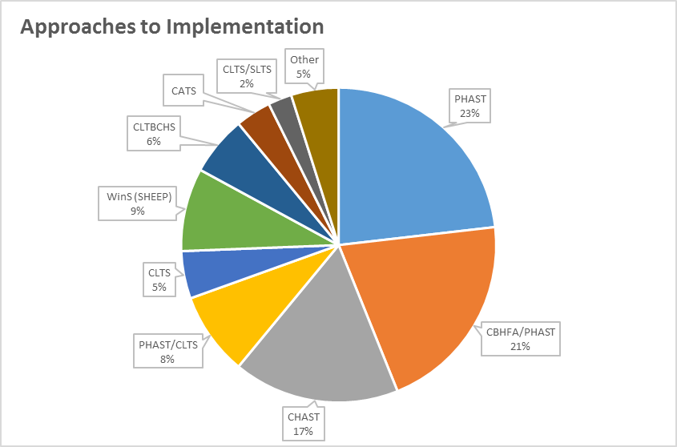
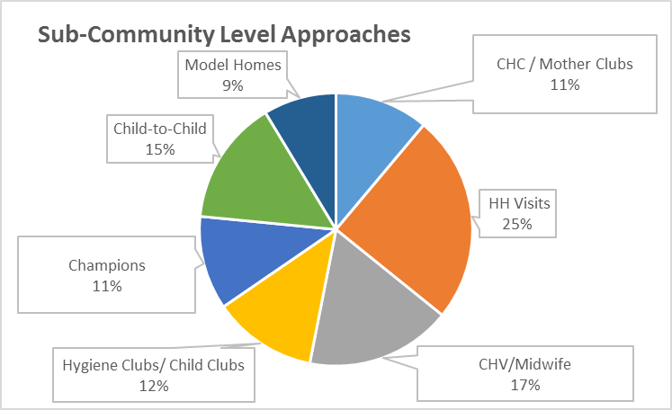
Approaches to Implementation
Community Level Approaches

Slide 7
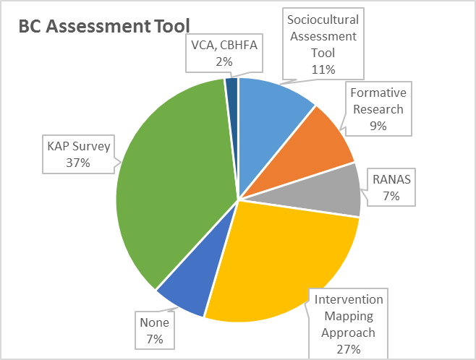
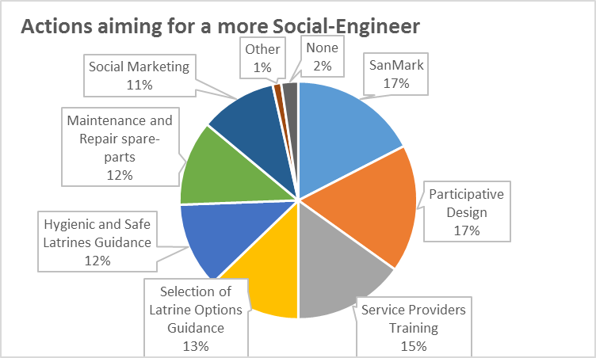
Behaviour Change Assessment
Socially and Culturally Adapted Hardware

Slide 8
Key challenges identified
Mainly through KIIs and desk-review
Summarized and structured into 3 areas: Capacity, Programmatic, Software / Approaches
CAPACITY RELATED CHALLENGES:
Hardware specialists and ‘traditional’ WASH staff often have different competencies than are required for Software
Software expertise at National Society level varies widely, and needs to be strengthened particularly in: behaviour assessment (barriers, motivators etc.), selection of software approaches and tools, integration, MHM, behaviour monitoring and evaluation (including indicator development)
Specialised WASH software capacity within IFRC is limited
Loss of quality and impact as trainings ‘cascade’ down through NSs, branches to community-based volunteers.
Retention, monitoring and performance evaluation of community-based volunteers.
Notes:
Challenges identified through KIIs, desk-review and to some extent the survey
Summarized and outlined in the ‘Gaps and Recommendations report’ from late 2016 which was reviewed by the TWG with feedback incorporated.

Slide 9
Your feedback and input needed!
Challenges faced – 3 areas: Capacity, Programmatic, Software / Approaches
Which challenges/gaps would you prioritise?
Please score/rate them on a scale of 1 to 5:
1 – very high priority or importance
2 – high priority or importance
3 – somewhat important
4 – low priority or importance
5 – not a priority / not important
What challenges/gaps are missing?
Notes:
We need your collective wisdom! Will feed into and guide the roll-out plan.
Split into groups to make it faster: 20 participants divided into 3 = 6 or 7 in each group
Each group has 5 mins at each station: read through the key challenges; identify if anything is missing; then score/rate each challenge (on scale of 1 – 5 as outlined on slide)

