Slide 1
WASH in the Middle East & North Africa
Update March 2017

Slide 2
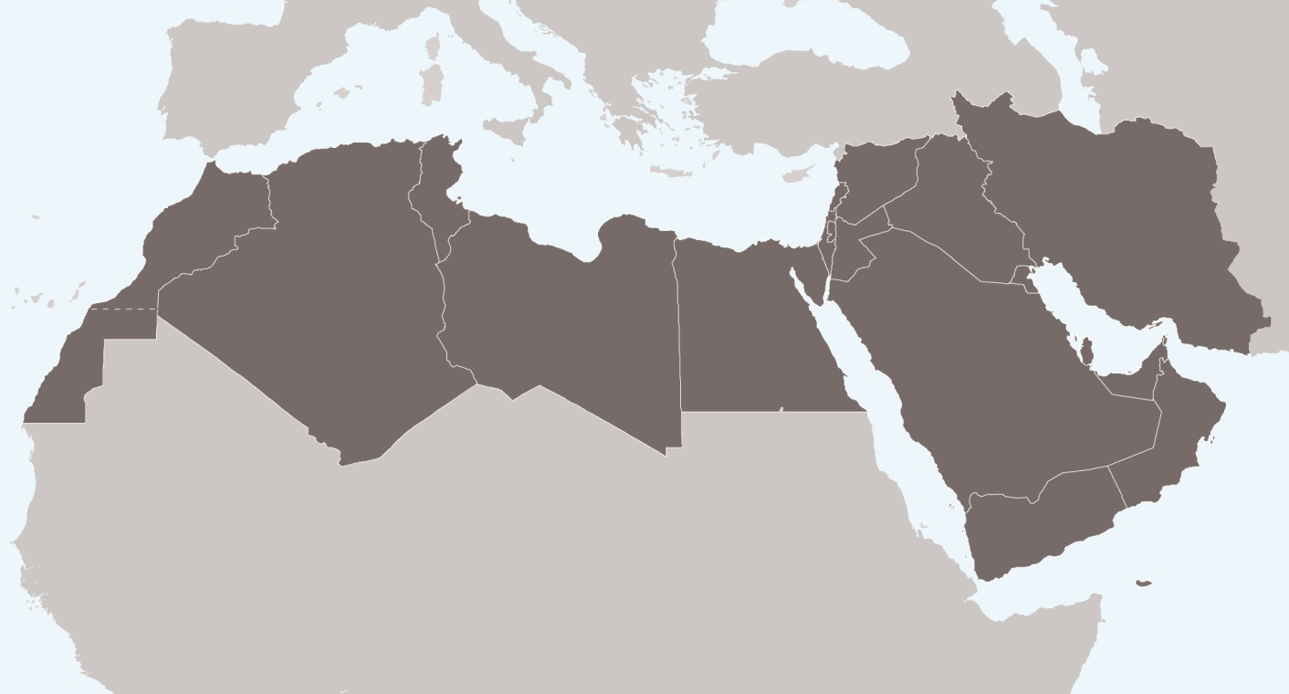
WASH in the MENA Region: the last year
WASH & Health
How can IFRC best support NSs?
What is our value-add?
How do we manage disasters / use our global tools?
How do we coordinate?

Slide 3
2017 Operational Plan Key Themes
Develop technical guidance materials for WASH equipment & best practice in Arabic
Develop PMER capacity of NS
Convene MENA regional Red Cross Red Crescent Movement WASH technical and coordination meetings
Simulation / RDRT / DMAG / capacity trainings

Slide 4
SMCC – Syria Pilot

Slide 5
SMCC – Iraq: an emerging case
Huge needs, huge challenges…
Closure of IFRC country office
Working ‘behind the scenes’
Lateral thinking RE: global tools
Strong support from PNSs
Growing relationship with ICRC

Slide 6
MENA Regional WASH meeting: March 2017
Day 1: Current context
Health & WASH
NS updates
Challenges / successes / gaps
Day 2: The way forward
Formalise engagement

Slide 7
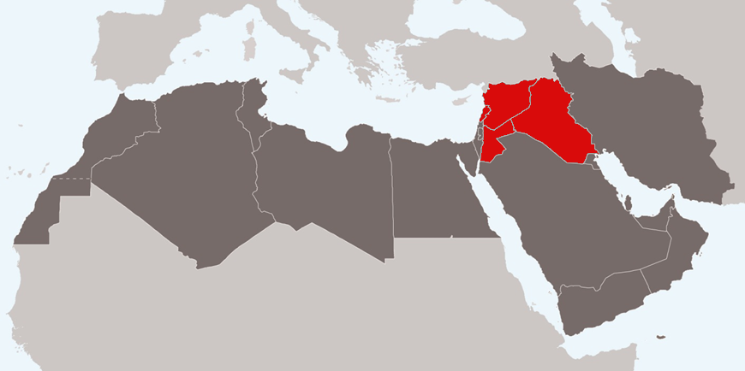
Q3 Review + 2018
Expansion outside Syria Crisis
Strengthening SMCC
Planned country-level activities
NSs better equipped in Arabic

