Slide 1
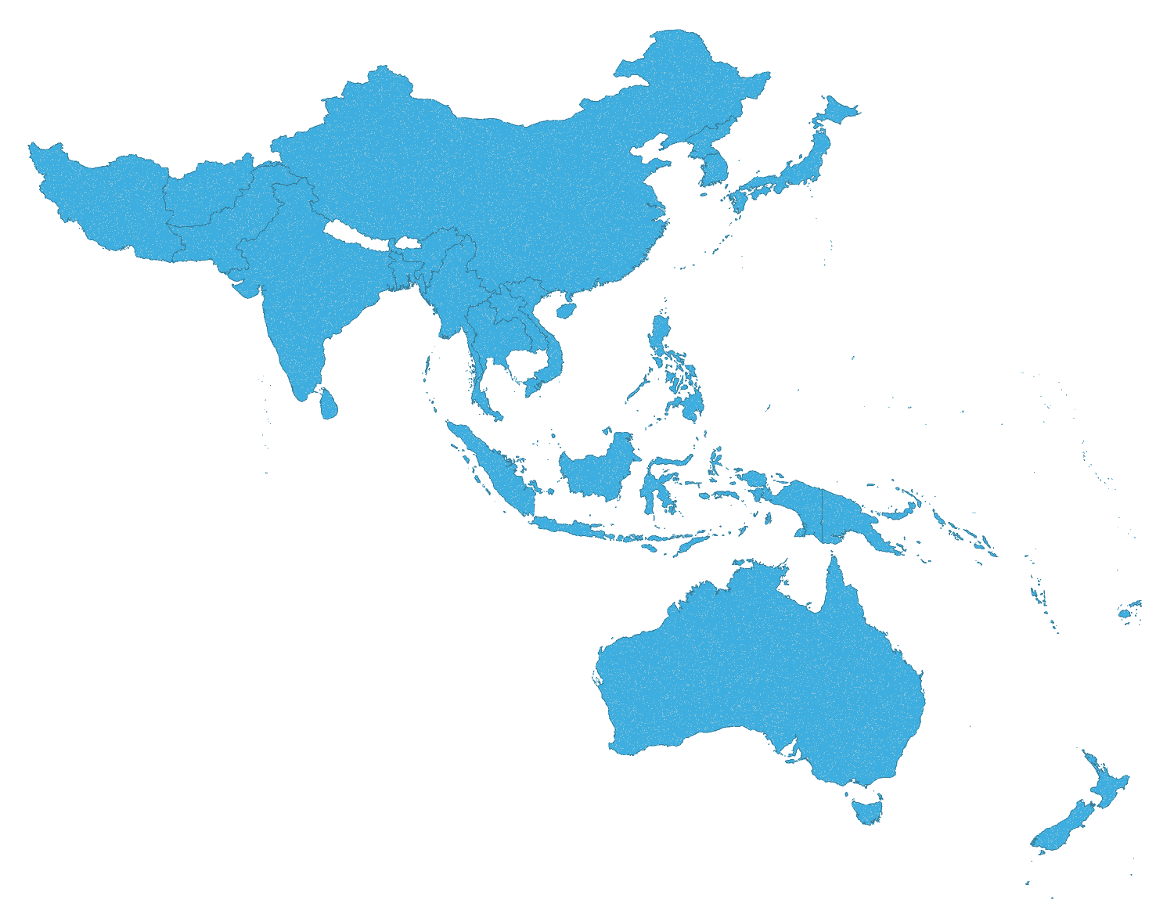
AP IFRC support to NSs 2015/2016
Country | Appeal Code | Event | Launched
Fed. States of Micronesia | MDRFM001 | Typhoon Maysak | 04 Apr 2015
Myanmar | MDRMM006 | Floods | 05 Aug 2015
Bangladesh | MDRBD015 | Cyclone Komen | 12 Aug 2015
Pakistan | MDRPK011 | Floods | 13 Aug 2015
India | MDRIN015 | Floods | 14 Aug 2015
DPRK | MDRKP007 | Floods | 21 Aug 2015
Papua New Guinea | MDRPG005 | Drought | 17 Sep 2015
Philippines | MDRPH019 | Typhoon Koppu | 21 Oct 2015
Pakistan | MDRPK012 | Earthquake | 03 Nov 2015
Indonesia | MDRID010 | Forest Fires | 04 Nov 2015
Afghanistan | MDRAF003 | Earthquake | 05 Nov 2015
India | MDRIN016 | Floods | 01 Dec 2015
Mongolia | MDRMN005 | Extreme Winter Condition | 15 Jan 2016
Viet Nam | MDRVN013 | Drought and Saltwater intrusion | 08 Apr 2016
Timor Leste | MDRTP004 | Drought | 18 Apr 2016
Sri Lanka | MDRLK005 | Floods and landslide | 21 May 2016
Bangladesh | MDRBD016 | Cyclone Raonu | 25 May 2016
Country | Event | Launched
Nepal | Earthquake | 27 Apr 2015
Myanmar | Floods | 11 Aug 2015
Bangladesh | Cyclone Komen | 25 Aug 2015
Pakistan | Floods | 28 Aug 2015
Fiji | Tropical Cyclone Winston | 01 Mar 2016
Mongolia | Extreme Winter | 01 Mar 2016
Sri Lanka | Floods and landslide | 18 May 2016
Bangladesh | Cyclone Raonu | 24 May 2016
 | DREF operations | Emergency appeals
Jun 2016 | 18 | 8
Notes:
So how do all these disasters in the AP relate in numbers – especially when it comes to utilising some of the funding mechanisms of IFRC such as the DREF and Emergency Appeal? DREFs and EAs will be explained in the next webinar so please bare with us regards to the jargon
So from approximately the same period in 2015 until now we have had 15 DREFs and 6 Emergency Appeals – which given my almost 3 years here would appear still to be an average year.
What is important is that most of these disasters are not isolated events to certain countries but more increasingly trans-boundary disasters.

Slide 2
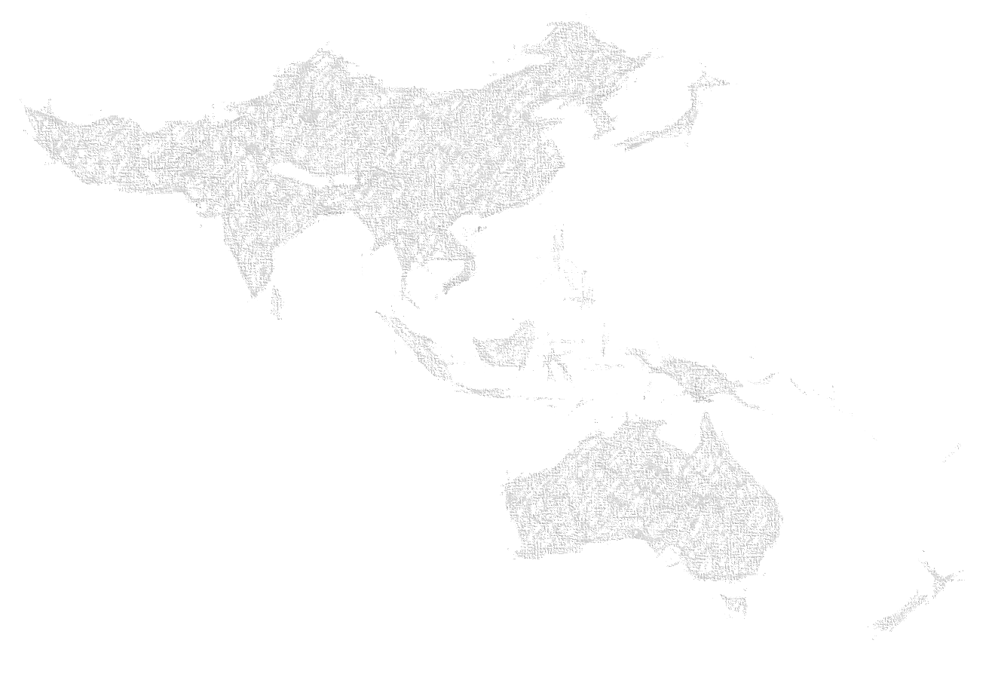
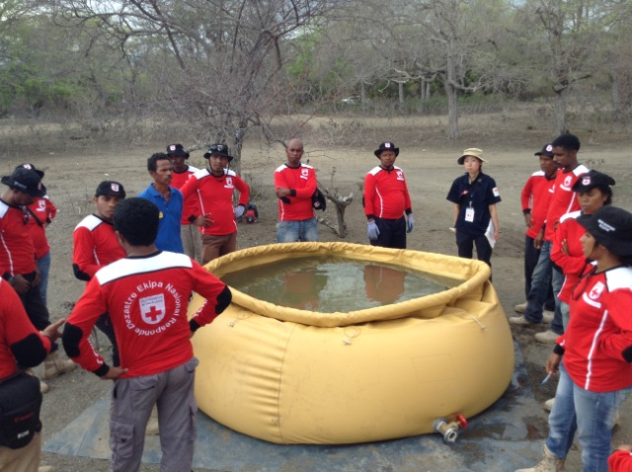
APRO Achievements 2015 - 2016
Scale up of WatSan in Emergencies:
Technical assistance in procurement of emergency WASH equipment for Bangladesh, PNG and the Pacific in 2015;
In 2016 support to Cambodia, Laos, DPRK and Pacific;
1st eWASH comprehensive simulation held in Indonesia

Slide 3
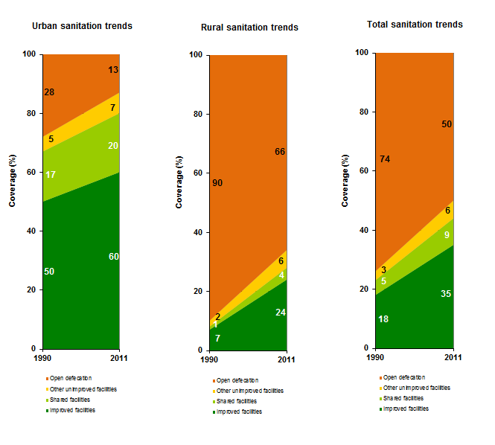
APRO Achievements 2015-2016
Scale up of GWSI:
Scaling up Sanitation proposal developed for 3 countries – bio-digester trial;
India bio-digester control site set up in Pune
DFAT (formerly AusAid) WASH programmes for Nepal and Bangladesh ongoing;
Samsung and Cartier WASH programmes for Myanmar, Cambodia and Indonesia started;
Second UrbSan workshop;
First IFRC RANAS training held;
Look Back Study in Bangladesh completed using RAMP;
2nd ToC workshop held in Myanmar

Slide 4
WatSan knowledge sharing 2015-2016
Hygiene Promotion Box adaptation – on going
PHAST ToT webinars and training
3rd year of eWASH
Webinars on MHM, Nepal EQ response, CBT kits and WASH and Markets
2nd UrbSan Workshop in Kathmandu – followed by webinar
Photo: Jurg Graf, Austrian RC
Notes:
14 HWTS manuals languages translated – 3 more in Pacific PNG, solomons Vanuatu and printed for Philippines
HP Box adaptation in India, Bangladesh, Nepal finished in Philippines , Indonesia , Vietnam, Myanmar

Slide 5
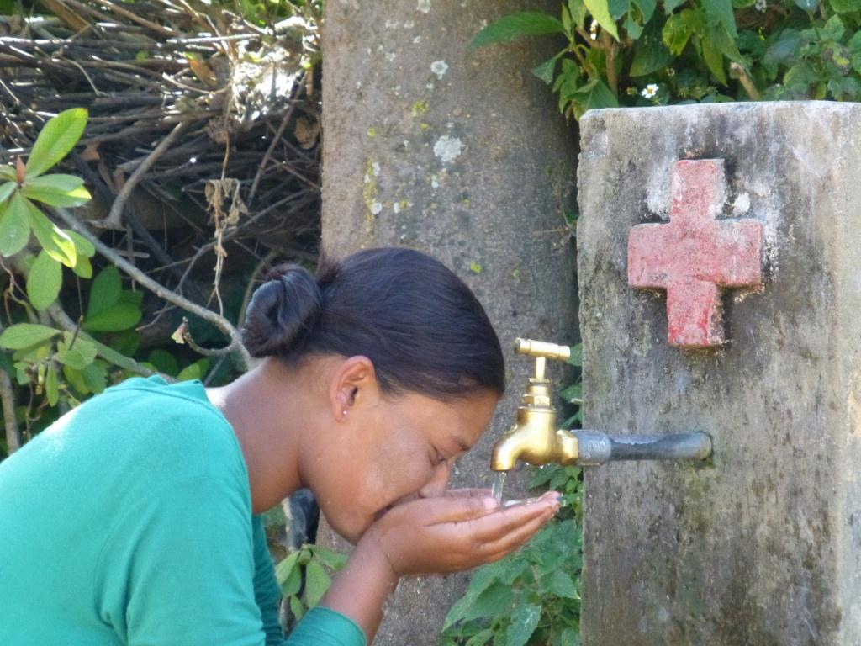
APRO Plans for 2016/2017
2nd Pacific eWASH webinar (September 2016);
Pacific emergency WASH face to face training in Suva (October 2016)
ER WASH training in Bangladesh, Cambodia, Laos and DPRK;
Bio-digester pilots in Nepal, Bangladesh and Philippines;
Scope for AP Flagship to be developed – watch this space!!

Slide 6
APZ IFRC Capacity in 2016
IFRC Staff approx. 10
Current: 01/09/16

