Slide 1
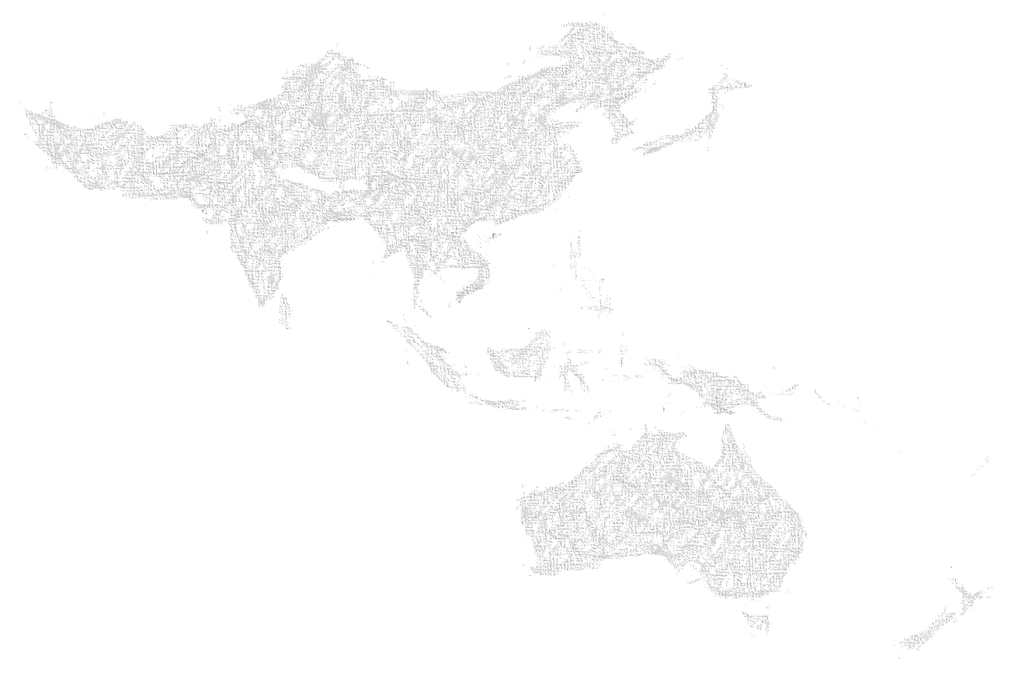
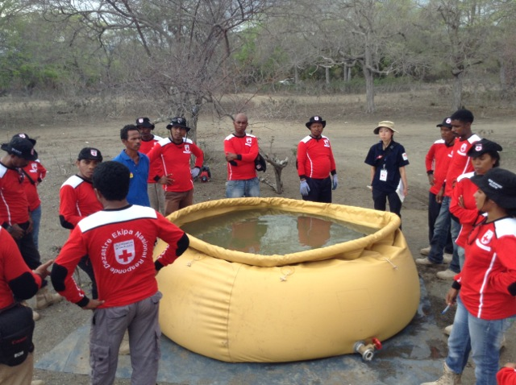
Stage 1: Webinars
Who Passed?
65 people from 17 NS, IFRC and ICRC;

Slide 2
Stage 2: Prior to Deployment
Day | Date | Inject
-4 | 20 July 2016 | Mock DMIS alert to be sent to all participants using RMS
-3 | 21 July 2016 | Second RMS alert with request for RDRT and Information Bulletin
-2 | 23 July 2016 | Third RMS Alert with attached ToR and DREF to all participants
-1 | 26 July 2016 | Pre-deployment webinar briefing from HR, Health, Logs, PMER, DCPRR, IT and Comms

Slide 3
Stage 3: Deployment and intervention
Day | Date | Inject
0 | 31 July 2016 | Participants all mobilised to Bandung, Indonesia and receive necessary briefings from IT, Logs, admin, overview of situation from PMI and security briefing from HeOps. Technical briefings also given and expectations for deliverables set. IM structure presented and need to collect data with Magpi. News inject and request from PMI for RDRTs to mobilise to 3 different areas
1 - 3 | 1 - 3 August 2016 | Teams get ready to mobilise and start assessments with Magpi and WASH market surveys. Mass Water, sanitation and HP. Note RDRTs to show PMI volunteers and staff on how to undertake interventions.
3 | 3 August 2016 | Major inject with Cholera outbreak in Jatinangor – all teams to handover to each branch and demobilise to base
Photo: Jurg Graf, Austrian RC

Slide 4
Security Briefings

Slide 5
Stage 4: Cholera Outbreak
Day | Date | Inject
4 | 4 August 2016 | All RDRTs back to base and briefed on new situation – Cholera outbreak by MoH and UNICEF Guidelines for CTU presented RDRTs 1 team now with a nominated WASH coordinator Intervention starts with assessments using magpi, production of specialised water etc Field and HQ coordination meetings led by UNICEF
5 - 6 | 5 - 6 August 2016 | Full intervention with CTU set up, production of water, model latrines, HP in community and schools
6 | 6 August 2016 | Debrief and party
Photo: Jurg Graf, Austrian RC

