Slide 1
Delegates Health
“Stay Healthy - Be Happy”

Slide 2
Vaccinations
Tetanus + Diphtheria 10yrs
Polio 5yrs
Measles lifelong
Yellow Fever 10yrs
Meningitis 3yrs
Hepatitis A and B 15yrs
Typhoid 3yrs
Cholera 6 months
Rabies 3 years
Japanese B Encephalitis 1-3yrs
Seasonal Human Influenza 1 year
Keep a copy separately in case you loose your original records

Slide 3
The greatest health hazards
Stomach up-sets, food poisoning
Traffic accidents
Malaria and Dengue fever
STI’s including HIV
Stress
Substance abuse such as excessive drinking and smoking

Slide 4
Air Travel
High risk of Deep Vein Thrombosis (DVT) after 4 hour flight
Consider the use of knee-length gradient compression stockings
Avoid dehydration by drinking at least 2 dl of non-alcoholic beverage / hour
Move your feet and legs regularly
Increased risk for smokers, short (<160cm) and tall (>190cm) people
Before flight: take 100mg aspirin?
Jetlag can be prevented

Slide 5
First Aid Preparedness
In the delegation there might be:
First Aid Kit for Vehicle in every Federation car (compulsory)
Health Delegate Kit
Burns Kit
Trauma Kit
Resuscitation Kit
Sterile Kit
Home First Aid Kit in every house
Earthquake Kit including FA equipment
Check them regularly.
All staff should have basic first aid skills updated annually.

Slide 6
Personal Medical Kit
For basic first aid and minor health problems
Bandages, medicines, sterile syringes and needles, malaria self test, disinfectant, ORS, condoms, thermometer, talcum powder, eye drops/cream, sun screen, antiseptic cream
Advisable to carry in hand luggage, sharp things in suit case

Slide 7
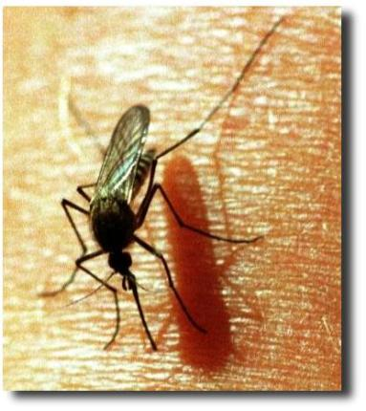
Malaria
Malaria is an acute febrile illness
with an incubation period of 7
days or longer. Might be fatal.
Malaria parasite is transmitted by Anopheles mosquitoes, which bite mainly between dusk and dawn.
Prophylaxis and treatment exists
Common in over 100 countries

Slide 8
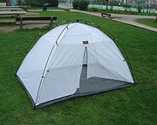
Malaria Prophylaxis
Use repellent
containing DEET 35%
Mosquito coil
Right clothing
Treated mosquito dome (or bed net)
Medicines: -Doxycycline 100mg
-Lariam
-Malarone
Needs to be taken prior to travel

Slide 9
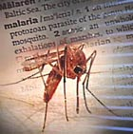
Dengue Fever
Viral hemorrhagic fever transmitted by day biting mosquitoes
Incubation period 3-14days, commonly 5-7days
No vaccine exists
You can protect yourself from dengue
Spray office premises every month

Slide 10
Dengue Signs and Symptoms
Sudden fever
Headache
Bleeding
Skin-Rash
Needs to be treated in
receive safe blood if
Joint pain
Muscular pain
Retro-orbital pain
Shock
a place where you can
necessary.

Slide 11
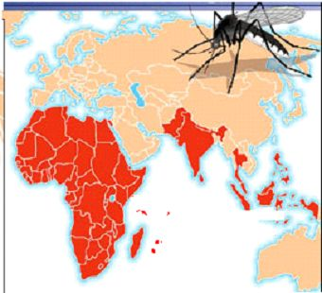
Chikungunya
Viral disease
Transmitted by mosquitoes
Incubation time 3-11 days
Rapidly increasing specially
in Asia and Africa
Symptoms: Fever, arthritis, rash, haemorrhages
Specific treatment: none

Slide 12
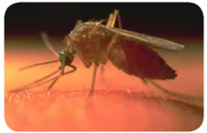
Filariaris
Lymphatic filariasis is caused by paracites carried by Wucheria bancrofti mosquitoes
Causes ”Elephantiasis leg”
120 milj. people in tropical areas are infected
Common in e.g. Haiti

Slide 13
Avian Influenza = “Bird Flu”
No good vaccine available yet
Seasonal Human Influenza vaccine for some prevention recommended by WHO
Tamiflu tbl for cure
N95 Facial masks or PPE for protection
Stay away from poultry, eat only well-cooked chicken
Good hygiene important
Risk for pandemic outbreak high

Slide 14
Medicines
Take them regularly at right time
Take them with right food
Store them carefully
Be aware of side effects
Counterfeit medicines are common
in many countries
Don’t forget your sun screen products

Slide 15
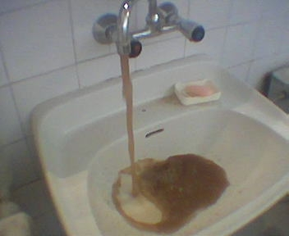
Water
Tap water is not drinkable
in many countries
Source of many diseases
Avoid ice if source unknown
Swimming is highly risky. There might be rip currents and undertows in the ocean. Please read the swimming advisory carefully.
Don’t swim alone.

Slide 16
Wounds
BE CAREFUL AND TRY TO AVOID THEM!
Careful treatment, even small wounds and skin infections might become serious illness
Risk of tetanus, check your vaccinations
Know where the nearest PEP (post exposure prophylaxis) kit is, should be mentioned in the medical evacuation plan

Slide 17
Hygiene
Hand disinfection is essential
Toilet hygiene – clean toilets every day
Try to avoid:
Sexually Transmitted Infections (STI)
HIV/AIDS
Fly control is essential
Prevention is better than cure

Slide 18
HIV in Workplace
New directive on HIV in the work place
Committed to implement WP programs
A project to ensure organization wide implementation of workplace programs
Information available on FedNet
Includes:
Treatment for local staff if not otherwise covered
Each person will be dealt with on an individual basis
Adaptation of duties, and flexibility in terms of working hours possible

Slide 19
Mental Wellbeing
Read: “Managing stress in the field”
Take care of your team – you are a member of it
R&R – “Refuel your Reserves”
What is your survival strategy?
We have four stress counselors in Geneva whom you can contact (CONFIDENTIAL) by email, skype or phone, soon also two in each zone available

Slide 20
Stress
Feelings of distress in yourself and others are legitimate and not signs of personal weakness or lack of professionalism.

Slide 21
Signs of Cumulative Stress
Physical symptoms
Emotional symptoms
Mental signs
Relational signs
Behavioral changes
Collapse of belief systems

Slide 22
Prevention of Cumulative Stress
Use your personal resources fully
Know yourself
Share – communicate – be clear
Support each other
Ask for support from Geneva

Slide 23
Risk Assessment
To be done in each delegation
Look specially at:
Assessment of local medical and dental facilities and services
Traffic hazards
Snakes and other animals
Climate risks (altitude, humidity)
Cultural aspects

Slide 24
Delegate falling sick
Inform the Country Rep and Health delegate
Inform Health Officer in GVA (by phone)
Applies also if accompanying family member
is hospitalised (also deliveries)
Ensure that the person is monitored and followed up regularly and approriately
Inform Insurance company and if needed Assistance company by the HOD or designated person
Federation contracted delegates:
No SOS coverage during leave,
AXA Winterthur as normally
Sick leave document to be presented

Slide 25
Medical Evacuation Plan
Latest version of information on FedNet
Follow the SOP
The plan includes also info on location of the nearest PEP kit and safe blood
Must be known by all delegates
Always keep your passport, visa and insurance card with you, or copies of same
Give administration a copy of your passport and visa
HOD responsible for regular updates
If in doubt – send them out!

Slide 26
More information
“International travel and health” from www.who.int/ith
www.who.int
http://wwwn.cdc.gov/travel/contentReliefWorkers.aspx#
www.internationalsos.com Codes: 22AMMS000091
FedNet: Resources and services/
Support/HR/Health

Slide 27
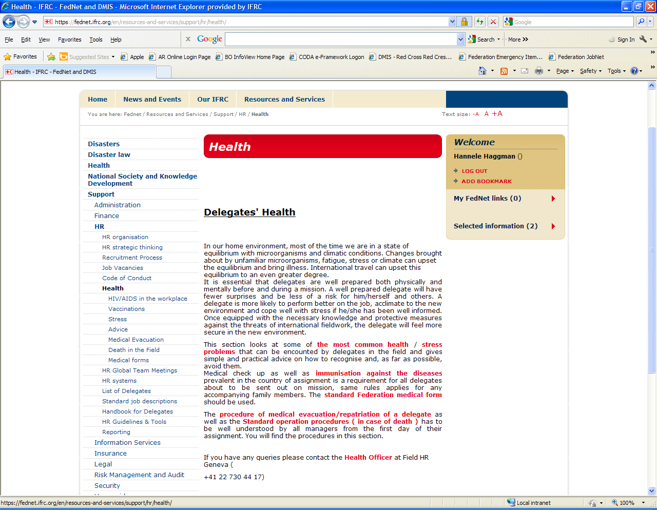

Slide 28
Health Insurance
Health Insurance for Delegates in the field
It is really important that the HR department is kept informed about all changes concerning delegates (marriage, birth, divorce etc).
Family members not declared to the HR dept: No insurance coverage for them!
Do not forget: Baby deliveries
-> GOP and child allowence

Slide 29
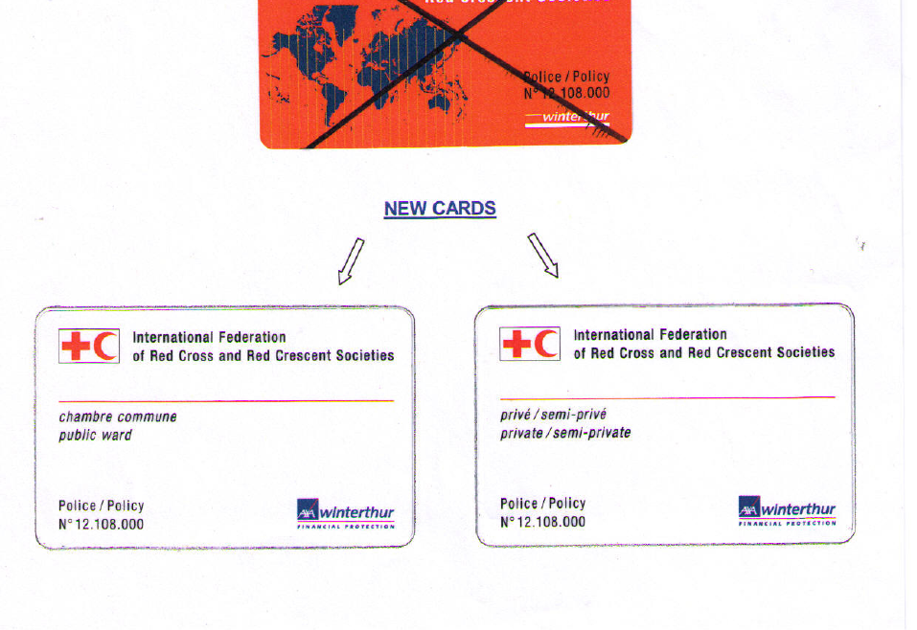
Insurance
Know the conditions of your own insurance policy
Insurance is not the same as Life Insurance
For Federation delegates: our contact in Federation for AXA Winterthur is
Francine Golay Tangen, Insurance Unit, GVA
E-mail: Insurance.Unit@ifrc.org
Basic information on benefits, general conditions, reimbursement and claim forms can be obtained from FedNet (Resources and Services – Support – Insurance)
Claims can now be done by email

Slide 30
For Federation contracted delegates: Annual Medical Check Up
Highly recommended for all delegates with Federation contract
Includes visit to GP and the basic health tests
AXA Winterthur will reimburse up to 500CHF once a year
End of Mission Medical
Highly recommended for all delegates
Same form as for Medical Clearance
Valid for a new contract for 6 months

Slide 31
Health Officer
Email:
Hannele.Haggman@ifrc.org
Skype: hannelehaggman
P.O. Box 372
CH-1211 Geneva 19
Switzerland
Direct line:
+41-22-730 4417
Mobile:
+41-79-217 3319
FAX:
+41-22-730 4958

Slide 32
QUESTIONS?
Take Care

