Slide 1
WASH update: West and Central Africa
Zakari Issa, WASH Coordinator 23 March 2017

Slide 2
Content
Humanitarian & Development snapshot
Overview of the RCRC in the Sub-region
IFRC ongoing initiatives and technical support
Plans for future

Slide 3
Humanitarian & Development snapshot
large-scale protracted humanitarian crisis and developmental issues affecting more than 150 mio people directly : abject poverty, fast population growth, climate change, recurrent food and nutrition crises, armed conflicts and violence, epidemics, ongoing and multiple displacement, under-investment in social services
humanitarian community will require US$ 2.66 billion to help 15 million people, across 8 countries.
Notes:
30 millions people affected by food insecurity, 1 in 5 children suffers acute malnutrition, 4.9 millions people fled their homes, population is expected to double in the next 20 years (Sahel)
more than 7.3 million people affected in 2016. Of these, 6.9 million need emergency assistance, including more than 4.2 million children (DRC); 2.9 million people (half of whom are women and over 60% of children) urgently need the most basic protection and / or assistance (Cameroun);
11 million people around the Lake Chad Basin need assistance, aid groups appeal for US$1.5 billion to assist 8.2 million people.
Insecurity persists in CAR; 1.6 million people are in need of assistance.
Epidemics continued to threaten communities across the region in 2017.
Funding commitment level of humanitarian and development effort is estimated at 8% of the needs

Slide 4
RCRC in the Sub-region
Multiplicity and ongoing active partnership mainly for humanitarian response with external: joint assessment and/or bilateral operations agreement in response to humanitarian crisis with external partners
Development programming is limited: few example could be traced with IFRC GWSI projects and other bilateral health and/or multi-sectoral programs (NLRC, FRC, DRC, SRC, BRC, consortium (BRC, LUXRC etc.)
Almost all NS strategic development plans include WASH as key component. but need to be updated and refined to fit this changing context
Overall resource mobilization efforts and WASH HR need to be expanded and refreshed (capacity building) and adapted to the context
More coordination is taken place between IFRC and ICRC WATHAB technical staffs above the traditional mechanism with external org.
Notes:
RDRT roster, tools and modules need to be reviewed
Emergency response is mainly through slow onset disasters (DREFs) which does not allow sufficient allocation for capacity building and roster development. Funding of humanitarian and development action is becoming a challenge. Unfulfilled commitment due to world political dynamics (Japan government etc..) Some PNS are transitioning/phasing out from the sub-region.
NS staffs and volunteers are used to implement operation for other organisations (UN systems, etc..). RC NS end up loosing some of the highly qualify staffs
Information exchange and coordination is being more active with ICRC. For example, we supported ICRC with modules and tools in Chad, identification of contractors for water management in Nigeria etc..

Slide 5
IFRC ongoing initiatives and technical support
Design, Pilot/implement multi-sectoral/flagship project in Ghana – 2016-2018
Design, Pilot/implement “post project” sustainability WASH programming in Côte d’Ivoire 2017-2010
Further expand GWSI WASH project to Senegal and/or Burkina Faso, 2017-2020
Initiating volunteering concept with corporate partners – since 2016
Active piloting and use of “real time” monitoring and evaluation of GWSI project using ICT – since 2015
Technical support to resource mobilization for Gambia and Cameroun, ongoing
Back up to operations and emergency roster – on going
Networking and positioning during national and international sectorial and high level forums and meetings (WCA platforms, GTFCC, WEDC, RWSS etc.
Further studies and evidence based anaylsis: water quality, look back study plans
Notes:
The ongoing initiatives are linked to the IFRC new WASH strategic direction, the flagship concept paper, S2020, SDG 6 unpacked RCRC indicators, updates from other WASH community learning and research, etc.

Slide 6
Plans for future
Revived WASH programming and learning : through RM and design for simple and innovative approach, ME&L – multisector/flagship programming, other considerations following ongoing initiative by the new IFRC WASH strategic direction
Update and expand HR capacity and availability: both emergency and development – Available CN for WASH RDRT in epidemics
Skilled Volunteering initiatives and/or secondment: to be further developed and rolled out – through PNS and PPP - Active partnership

Slide 7
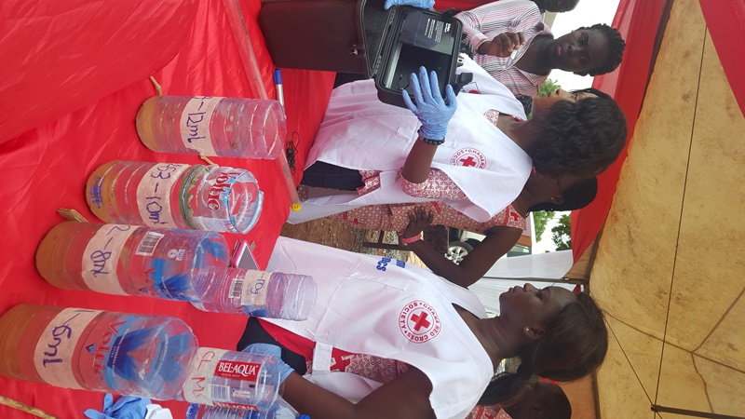
Questions??
Thank you for your attention

