Slide 1
WASH Advisors Meeting, Geneva Secretariat, 22-23rd March, 2017.
Noor Baya PWANI
Coordinator , WASH
EAIOI & Southern Africa

Slide 2
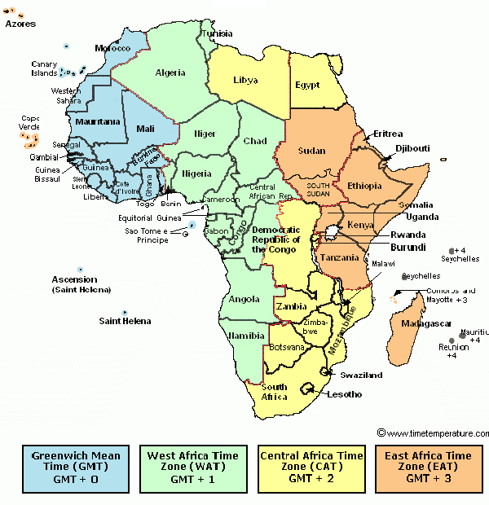
Updates: Eastern and Southern Clusters
Droughts
Floods
Epidemics
Population Movement
Combinations
WASH &HP SI
22% tech/23%
19% training/27%
16% networking/15%
13% logistics

Slide 3
WASH- Addressing Chronic Needs
Urban Sanitation Project in Eritrea:
Public Latrines in 6 Towns /Cities & HP
OPEC funding in Zambia
Rural WASH &HIV Prevention Western Zambia (1 district)
Land Rover WASH project in Uganda:
Rural WASH in 2 districts
Djibouti WASH:
Rural WASH in 2 districts
Bilateral WASH Projects

Slide 4
WASH – Acute needs Emergency Appeals and DREF
Drought Related:
Kenya , Ethiopia, Somali- EA
(Eritrea*, Djibouti*, South Sudan*- No decion for Appeal or DREF)
Population Movement (most Current)
Tanzania, Uganda.
Floods Related:
Namibia (D), Mozambique (D), Madagascar (EA), Botswana(D) , Zambia (D)
Epidemics: Cholera in Ethiopia, Malawi, Mozambique, Somali

Slide 5
Way Forward:
Winding up ongoing long term /Support emergency Ops and Exit Strategy
Urban WASH Pilot in Sululta Ethiopia.
WS study, Sanitation and HP in Schools and Community
Scale up Resource Mobilisation to Address Chronic Needs and those related to Epidemics (Uganda, Ethiopia, Madagascar, Zimbabwe, Mozambique ….)
Emergency Preparedness – Regional and Cluster WASH response teams training and Kits

