Slide 1
Urban WASH Technical Working Group Nairobi, September 2017 Urban planning & Water supply system for formalized IDPs camp – Haiti – Port au Prince
National Society(s) active in this Project:
1st Phase Urban planning: FRC & HRC for operation & implementation, and CRC for operation and technical collaboration
Water Supply: FRC & HRC for operation & implementation and AmRC for funding
Country/Location of Project: HAITI – Port au Prince
Title of Project/Case Study:
Durable solution for IDPs Camps: Urban planning
Water supply system for an improve access to water for formalized IDPs camps
Time scale of project:
Durable solution for IDPs Camps: : 25 months (but 20 months in reality)
Water supply: 18 months (but only 9 months funded by AmRC)
WHERE WE WORK

Slide 2
Urban WASH Technical Working Group Nairobi, September 2017 Urban planning & Water supply system for formalized IDPs camp – Haiti – Port au Prince
Approximate Total Budget (USD):
Durable solution for IDPs Camps: : 1,500,000 USD
Water supply: 568,000 USD
Target population:
Durable solution for IDPs Camps: : 1,162 people
Water supply: 10,000 people
WHERE WE WORK

Slide 3
Urban WASH Technical Working Group Nairobi, September 2017 Urban planning & Water supply system for formalized IDPs camp – Haiti – Port au Prince
What the project delivers in water supply: safer access to water (quality & quantity)
Hardware/Infrastructure (water network; Tanks Water points vs plot servicing => option at this stage of the project);
What the project delivers in Hygiene:
Software: sensitization on use of water, price of water etc.… (partially)
HH Water storage; (partially)
Capacity building of target population:
Land tenure support (administration process);
Committee with sub committee (including wash);
Training on finance, management, conflict resolution etc….;
Participatory urban planning
Capacity building of WASH service providers:
Procurement procedure
Technical support (design and implementation phases);
Management and operation (not yet included)

Slide 4
Urban WASH Technical Working Group Nairobi, September 2017 Urban planning & Water supply system for formalized IDPs camp – Haiti – Port au Prince
Describe Achievements and lessons learned ?
MoUs (DINEPA, UCLBP, Municipality…)
Urban plan (PRU) validated by Haitian institutions (MoE, MTPTC, DINEPA, Mayor etc…);
Water Supply technical study validated and integrated in DINEPA master plan for Metropolitan area of PaP;
LLH, Health/protection, DRR activities;
Lessons learnt:
The key is acceptance of the civil society, institutions ;
communication strategy;
need flexibility (financial, operational, project/program duration);
need an holistic approach (multi-sectors);
HR (urban planner, Wash PM)
Risk management (need to take risk)

Slide 5
Urban WASH Technical Working Group Nairobi, September 2017 Urban planning & Water supply system for formalized IDPs camp – Haiti – Port au Prince
Describe challenges ?
Political instability / Election (new mayor for municipality);
Chronic disaster that concentrate attention of donors on other areas;
Develop common vision and plan with all stakeholders;
Define area of influence of the program (IDP = ok / but surrounding neighbourhood impacted ;
Land tenure (secure HH),
Coordination mechanism
Costly program for low # of population
Win credibility with partners
What resources did you need or lack?
Extension of 9 to 12 months
250,000 USD to achieve the water network and support, reinforce capacity of service provider;

Slide 6
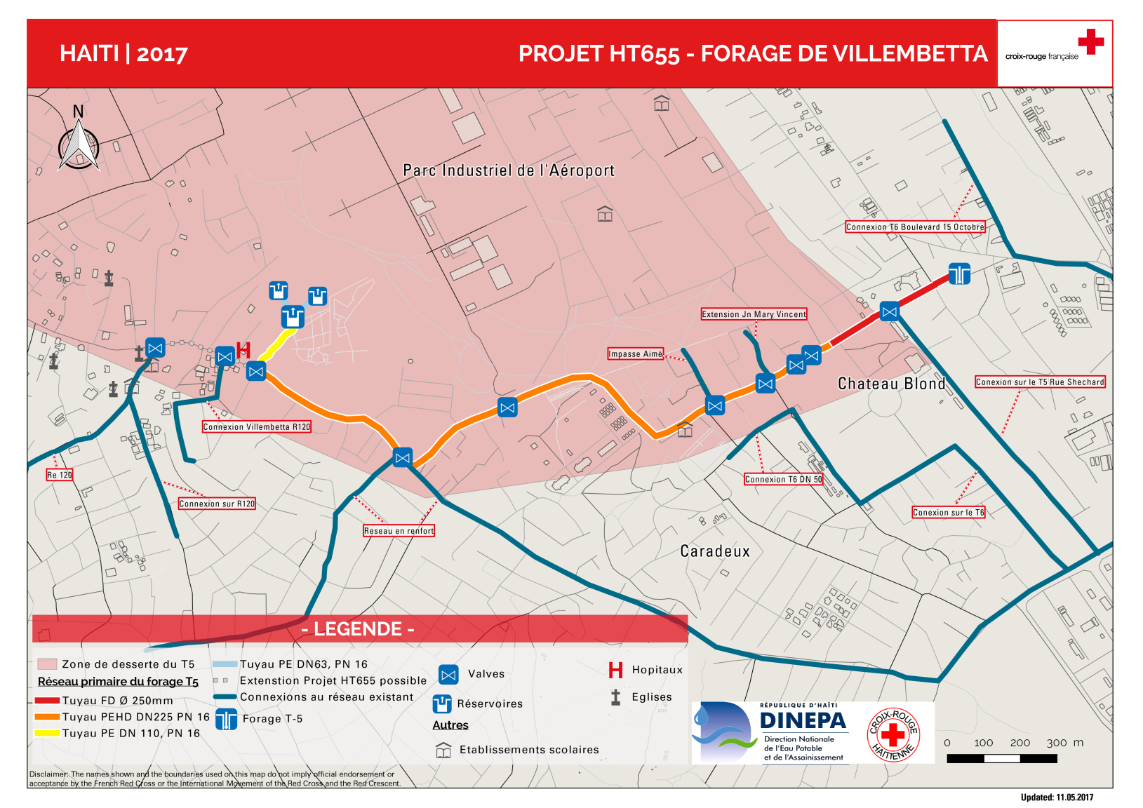
Project photos and any additional conclusions?

