Slide 1
Reduction of Child Mortality due to Diarrhea, Manila Project TWO (Toilet Water Oresol)
Federation WASH
Urban WASH Philippines
Urban WASH Technical Working Group Nairobi, September 2017

Slide 2
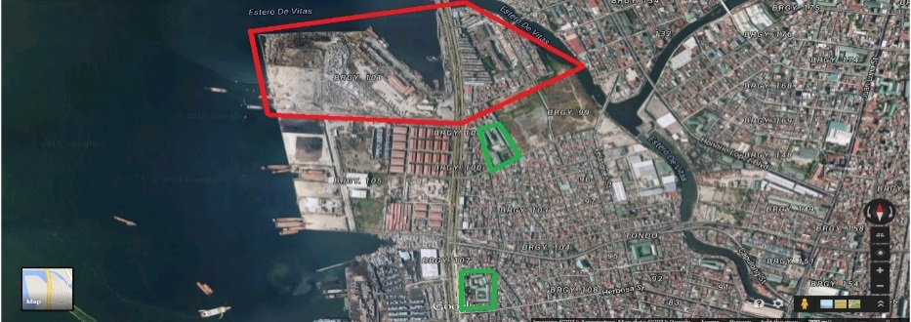
Reduction of Child Mortality due to Diarrhea Project TWO (Toilet Water Oresol)
Federation WASH
Implementing National Society: Philippine Red Cross
Supporting Partner National Society: The Netherlands Red Cross
Country/Location of Project: Barangay 101, Tondo, Manila
Time scale of project: January 2014 – December 2017
Approximate Total Budget (USD): 645,000 USD
Target population: Community:
Barangay 101 (+/- 2,300 HH/10,500 people)
Schools:
General Vicente Lim Elementary School
(+/- 5,000 students)
Amado Hernandez Elementary School
(+/- 5,000 students)
WHERE WE WORK

Slide 3
Urban WASH Technical Working Group Nairobi, September 2017 Reduction of Child Mortality due to Diarrhea Project TWO (Toilet Water Oresol)
Federation WASH
GOAL:
Contribute to public health resiliency by assisting the urban poor to maintain health and increase access to safe water and basic sanitation.
OBJECTIVES:
Increased use of community/household water and sanitation facilities
Improved home-based health care for diarrhea and prevention of dehydration
Increased ability to anticipate/ respond to disasters/ public health emergencies and prevent water and sanitation-related diseases
WHERE WE WORK
Community Program
Health and Hygiene Education: PHAST
Providing Water and Sanitation facilities
School Program
Training at schools: CHAST
Rehabilitation of Water and Sanitation facilities
Community and School program: Health awareness campaigns

Slide 4
Project in numbers:
Federation WASH
# of PHAST ToT: 18
# of CHVs trained on PHAST: 136
# of CHVs mobilized for PHAST: 98
# of families reached through PHAST: 1560 (2374?)
# of children reached through handwashing: 15,801
# of sessions facilitated on HP in schools: 171
# of individuals trained for school WASH committee: 27
# of schools and communities with access to safe water: 3
# of schools and communities with access to sanitation facility: 3 (except informal areas)
# of individuals reached through health sessions and campaigns: 8305
# of sets of essential hygiene items procured for prepositioning (hygiene kit, hyposol, jerry cans): 2500
# of soap bars distributed: 15,801
# students reached through CHAST: 10.000
# of staff trained in Epidemic Control: 15
# of CHVs trained in Epidemic Control: 32

Slide 5
Metro Manila, Philippines
Federation WASH
Manila urban region
1,474.82 km2
Population: 22.71 million
Metro Manila
613.94 km2
Population: 13 million
16 cities and 1 municipality
Metro Manila Water Supply and Sewerage:
MWSS (Metropolitan Waterworks and Sewerage System) served 30% of the metro for water and sewer services.
MWSS was privatized in 1997, split of concession into east and west zone
East zone served by Manila Water
West zone served by Maynilad Water Service
Manila City
Capital of the Philippines
Most densely populated city in the world
42.88 km2
Population: 1.78 million

Slide 6
Urban WASH Technical Working Group Nairobi, September 2017 Standard PP for Case Studies.
Federation WASH
Describe what the project delivers in water supply:
Improvement of water supply system in one school
Advocate for water connection for informal areas. Local water company in cooperation with the barangay leadership provided communal water connection to the different informal areas.
Session on safe water chain
Proper water handling promotion on eco-bags

Slide 7
Urban WASH Technical Working Group Nairobi, September 2017 Standard PP for Case Studies.
Federation WASH
Describe what the project delivers in sanitation:
Rehabilitation of WASH facilities in both schools
Increase in access to WASH facilities for community
Describe what the project delivers in Hygiene:
PHAST
Clean-up drives, incl. sustainability agreements (PRC, LGU, Residents)
BCC plan
BCC, proper solid waste management promotion via:
Mural painting context
Song writing contest
Zumba with songs from contest
Recycling contest
Signage
CHAST
Health and Hygiene campaigns, i.e. Dengue Awareness Month, Nutrition …, Oral Hygiene …., Global Handwashing Day, World Toilet Day, World Water Day.
ECV
EPRP
Describe capacity building of target population:
Training of WASH committee in schools
Training of BAWASA in community
Training of volunteers on PHAST
Training of volunteers on ECV
Describe capacity building of WASH service providers:
n/a, water company is already sufficient capacity

Slide 8
Urban WASH Technical Working Group Nairobi, September 2017 Standard PP for Case Studies.
Federation WASH
Describe Achievements and lessons learned, what worked well?
Adjusted PHAST IEC to urban context
New CHAST workbooks develop with the school teachers
Participatory BCC (Behaviour Change Communication) to complement PHAST.
BCC plan designed by key beneficiaries, volunteers, LGU staff and project staff.
BCC plan included: Mural paining competition, song writing competition, Recycling competition, Zumba on new songs,
Health and hygiene campaigns action based, for example clean-up drives, handwashing demo, etc.
Advocacy with Maynilad to extend water service to informal area
Rehabilitation of WASH facilities in schools, giving students better access to WASH facilities.

Slide 9
Urban WASH Technical Working Group Nairobi, September 2017 Standard PP for Case Studies.
Federation WASH
Describe challenges, what did not go so well?
Low community participation at the initial steps of PHAST
Finding landowner of informal areas
Community prioritize livelihood over WASH
Physical appropriate space for PHAST sessions
Appropriate and feasible sanitation options for informal community
3 very different kinds of areas in 1 community (informal, unit/appartement blocks, ‘proper’ houses) require different approaches.
What resources did you need or lack?
Context appropriate software approach and IEC materials (urban instead of rural)
Appropriate and feasible sanitation options for informal areas
Access to and timely support of the right government officials

Slide 10
Project photos and any additional conclusions?
Federation WASH
New approach in two following urban WASH projects through public private partnerships (PPP) consortium with international and local organizations and companies in Cebu and Cagayan de Oro.
Sustainable and resilient pro-poor water supply, Cebu (Philippines) is a 5 year’s Public Private Partnership (PPP) project. The overall goal of the project is to extend distribution and improve access to clean drinking water supply for 80,000 people, mostly poor, with 30,000 extremely poor people in the peri-urban/ slum area. The NLRC officially starts its activities from January 2016.

Slide 11
Project Partners

Slide 12
Project information
Project duration | : | 5 years (2015-2019)
Donor | : | Netherlands Enterprise Agency (RVO)
Total budget (€) | : | 7.2 million Where 3.9 million (54%) is subsidized by RVO and 3.3 (46%) million is contributed by 5 consortium partners.
Red Cross Budget (€) | : | 600,000 (50% subsidy and 50% NLRC contribution)
Consortium Lead | : | Vitens Evides Int. (VEI)
Project beneficiary | : | 80,000 people, including 30,000 extreme poor
Key deliverables for the NLRC | : | Provide hygiene awareness to the 20,000 slum dwellers Construct 12 latrine and hand washing stations in school and health posts Community capacity building on Disaster Resilience Community capacity building on latrine operation and maintenance

Slide 13
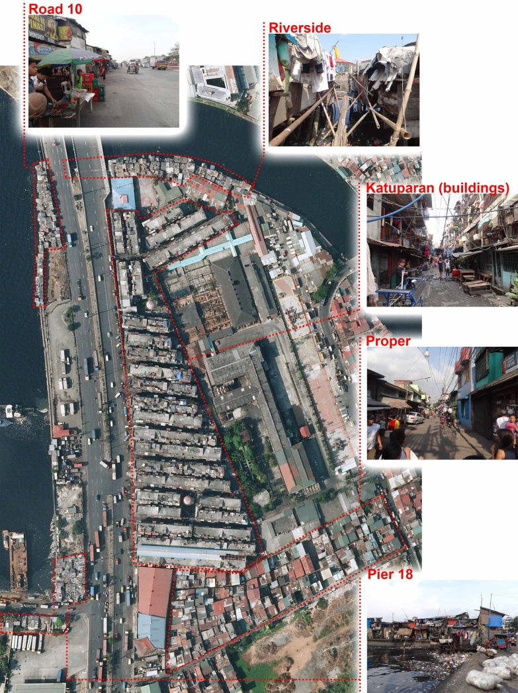
3 different contexts in 1 Barangay
Federation WASH
Project photos
Clusters:
Cluster 1: informal area (Pier 18, Road 10 and Riverside)
Cluster 2: Katuparan (buildings)
Cluster 3: Proper

Slide 14
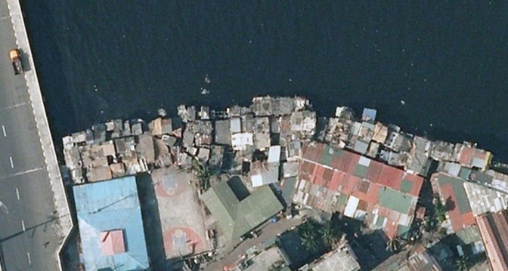
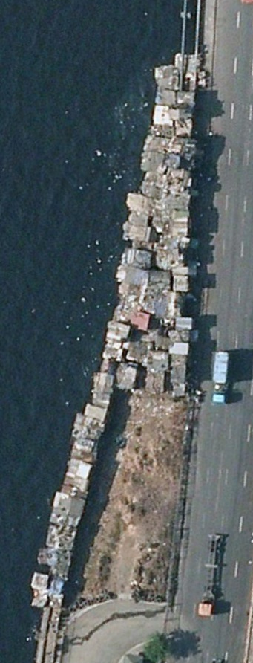
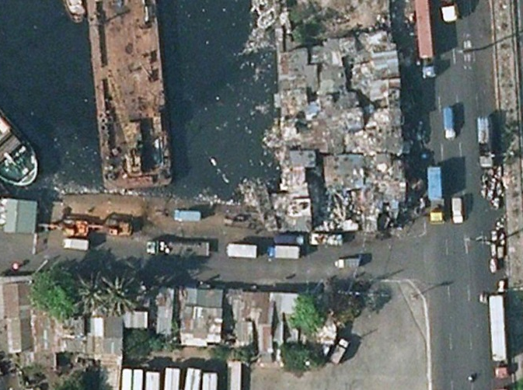
Cluster 1: Informal areas
476 households, 1868 individuals
Informal settlers
High poverty
High density
Low literacy
Barong-barong houses from scrap materials
No sanitation facilities, water supply via a communal hose
Main issues: sanitation, water supply, high tide, floods, solid waste management, livelihood

Slide 15
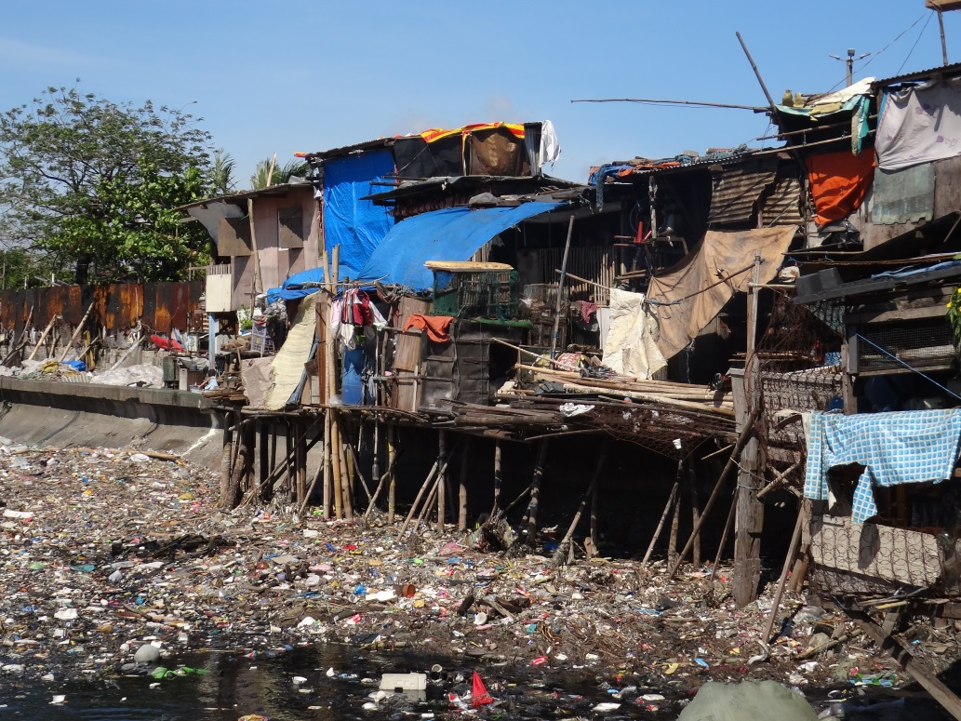
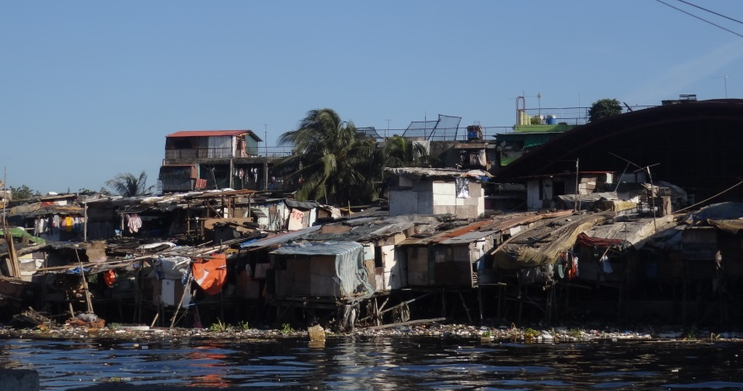

Slide 16
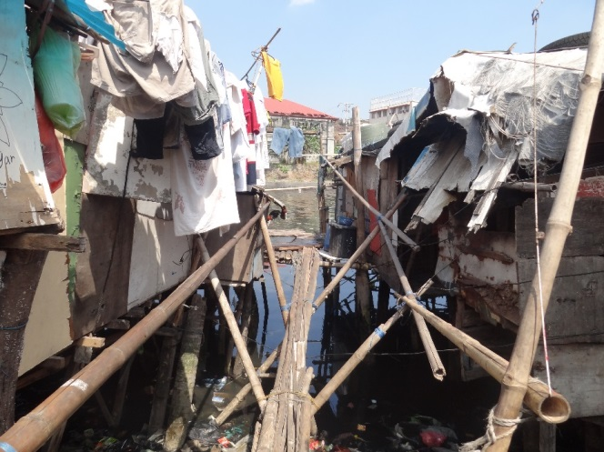
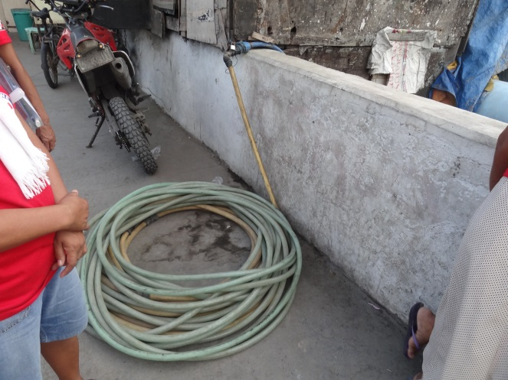

Slide 17
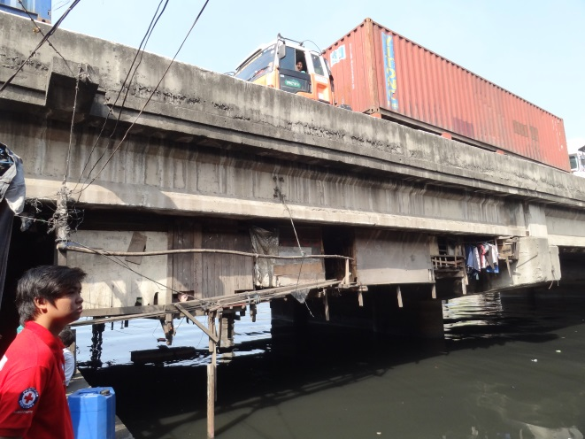
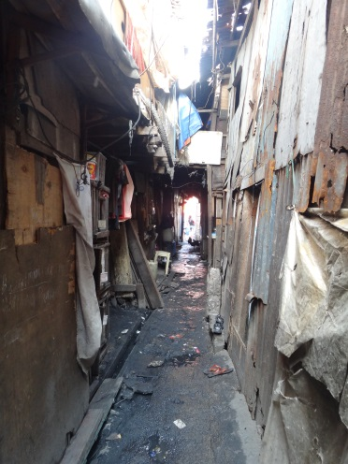

Slide 18
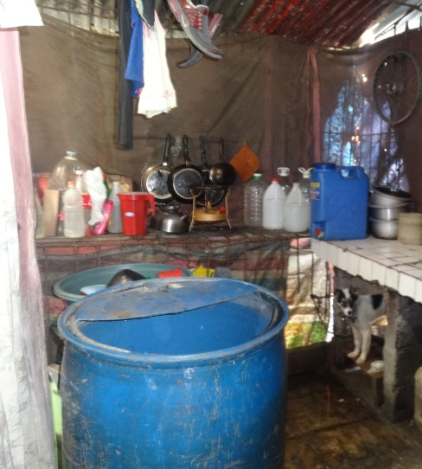
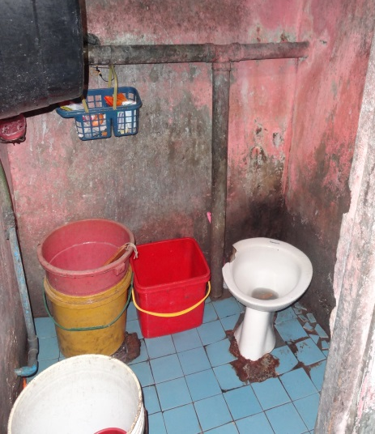
Cluster 2: Katuparan (buildings)
Federation WASH
1384 households, 6498 individuals in 27 apartment buildings
‘Temporary’ resettlement site from Smokey mountain in the 1980s
Formal inhabitants, threat of eviction. Informal settlers live on and around the buildings
Relatively well off
Buildings in disrepair and many self-built extensions
Each unit has its own toilet and formal water connection (difficulties with paying the bills), buildings have septic tanks
Main issues: solid waste management, drainage, state of septic tanks, earthquake, overpopulation

Slide 19
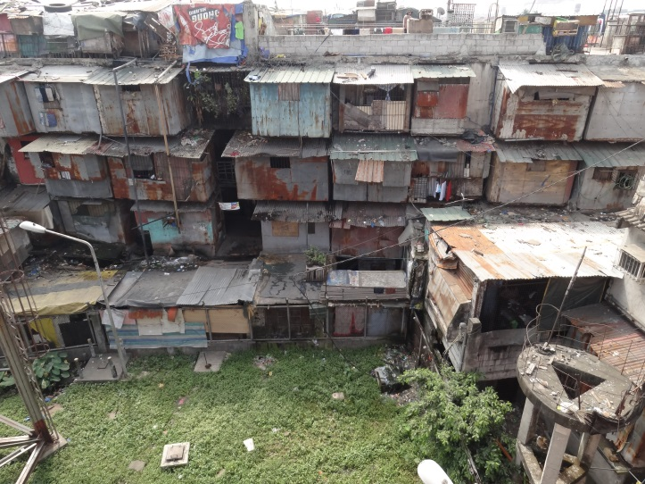
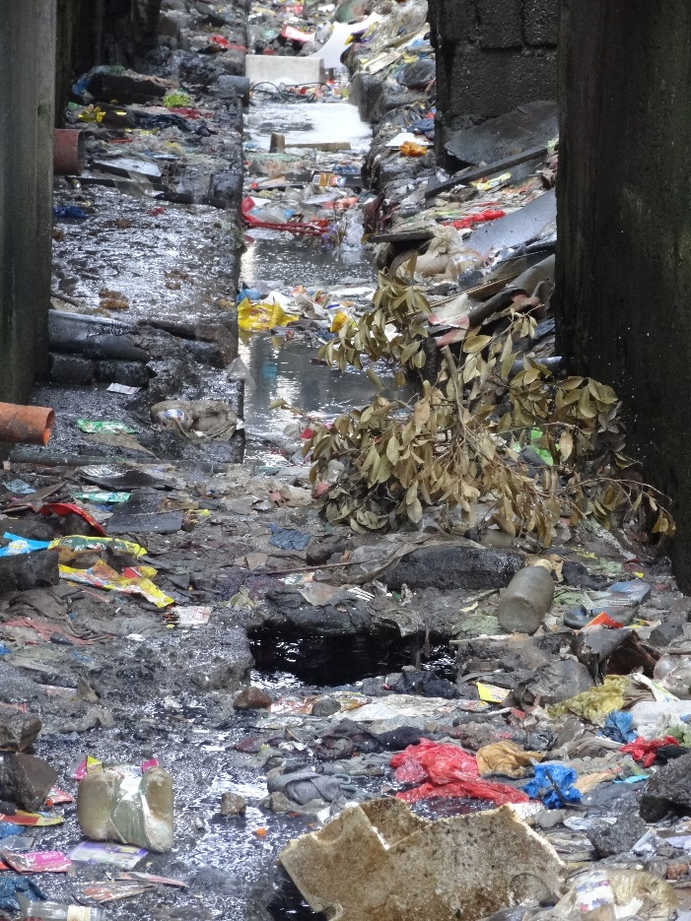

Slide 20
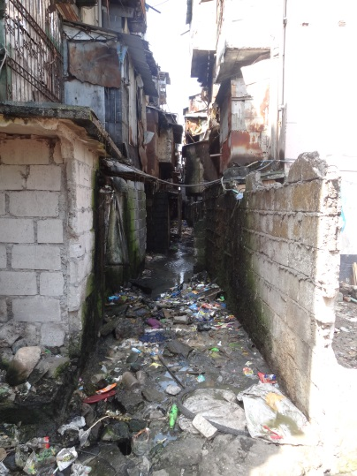
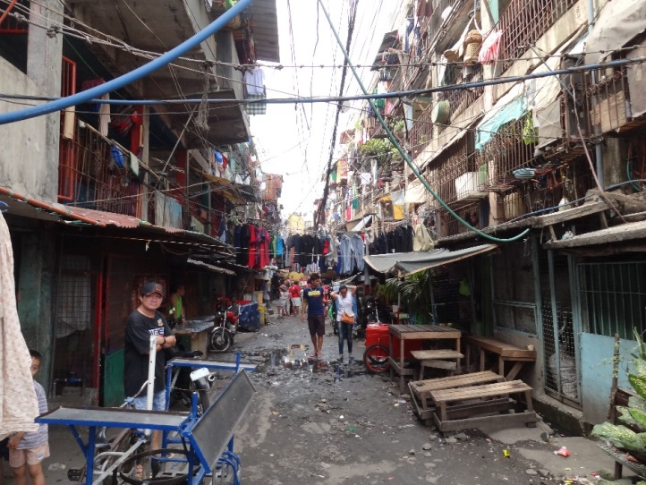

Slide 21
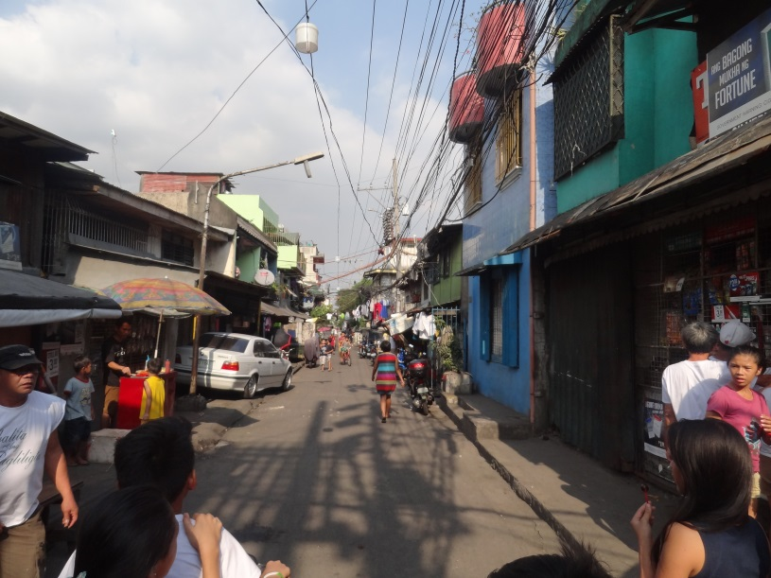
Cluster 3: Proper
Federation WASH
514 household, 2252 individuals
Mostly formal inhabitants with land rights
Relatively well off (financially)
Decent multi story concrete houses
High density
Mostly own toilet with septic tank and formal water connection
Issues: open urination, drainage, solid waste management

Slide 22
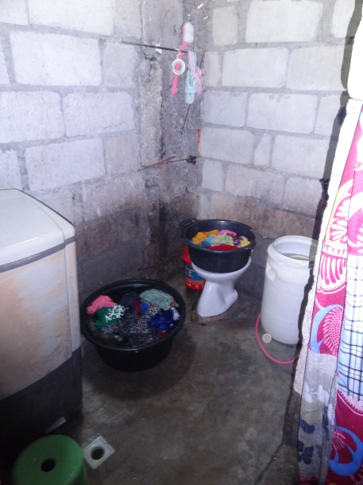
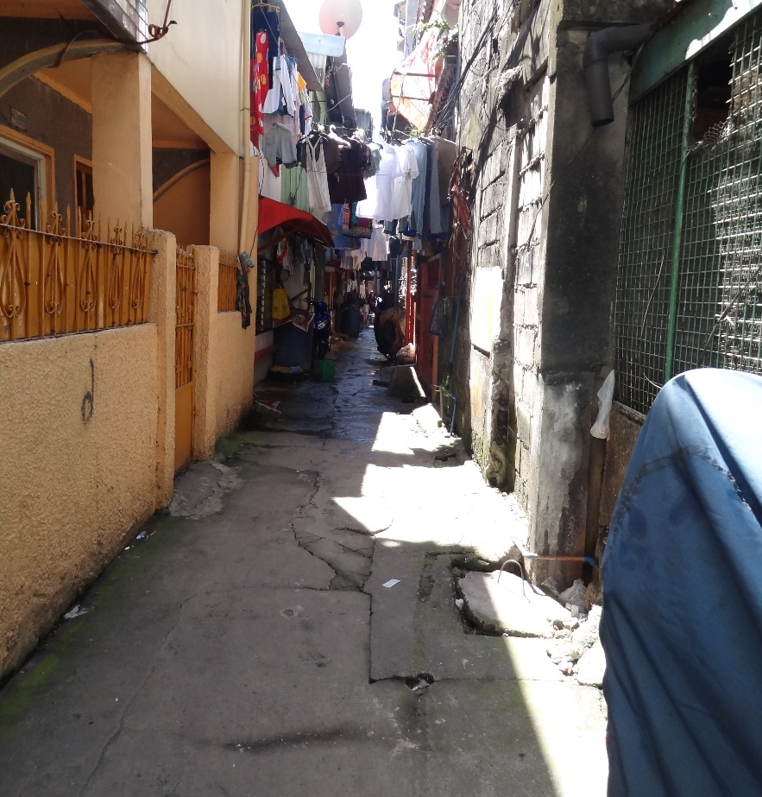

Slide 23
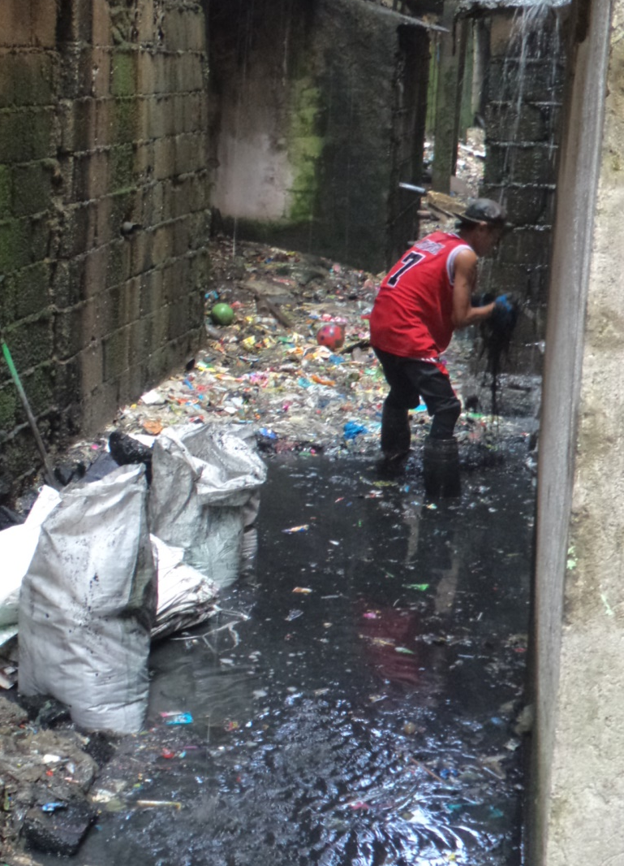
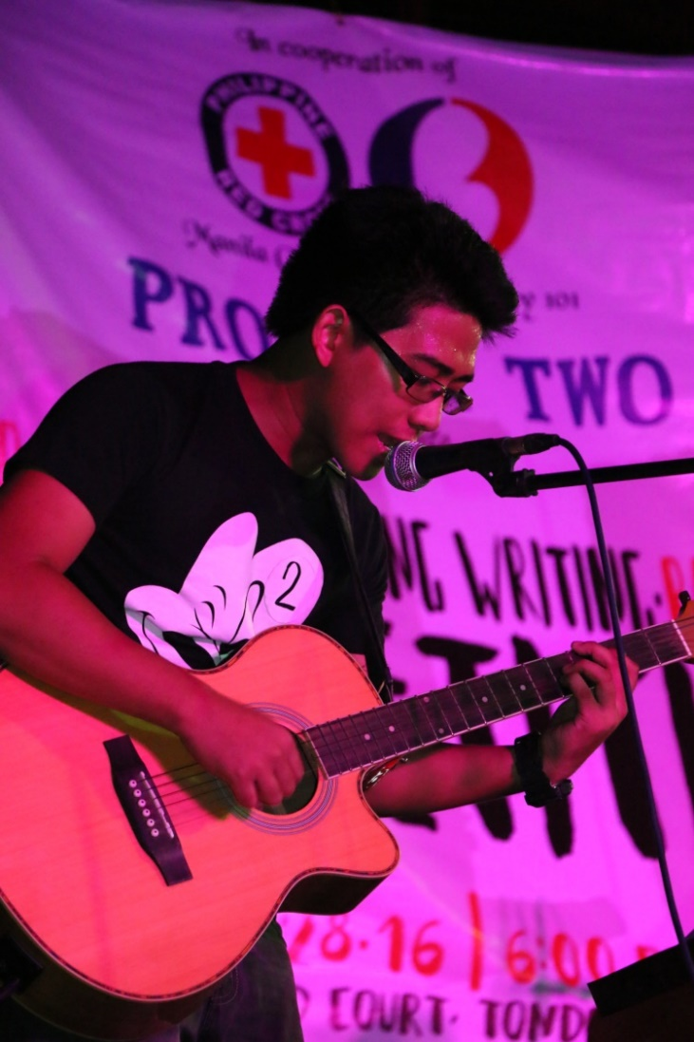
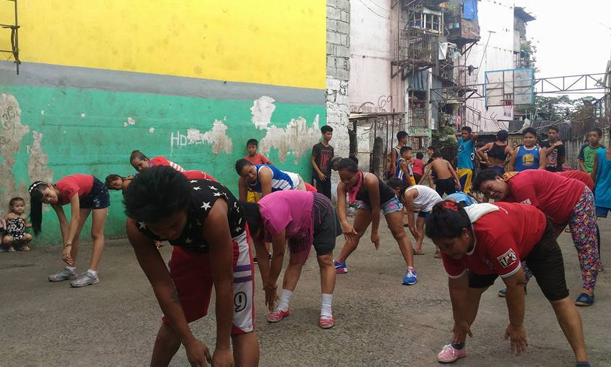
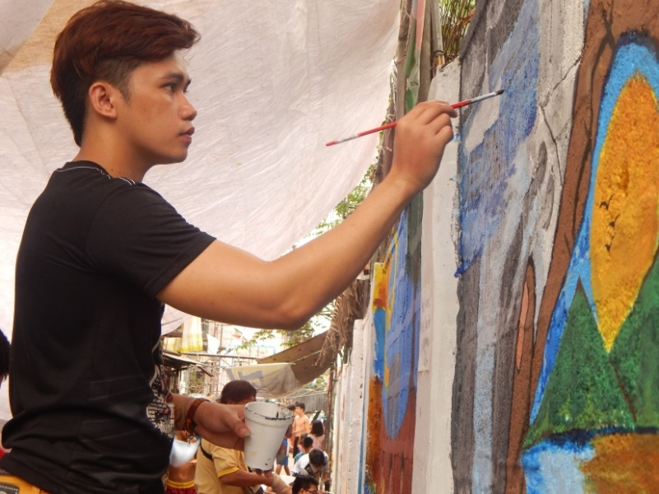
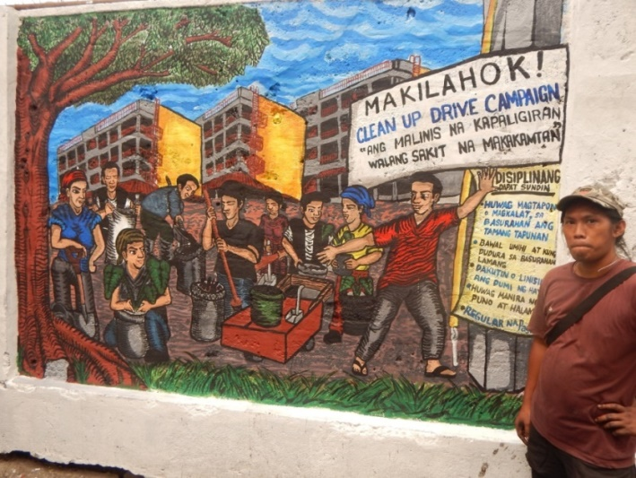
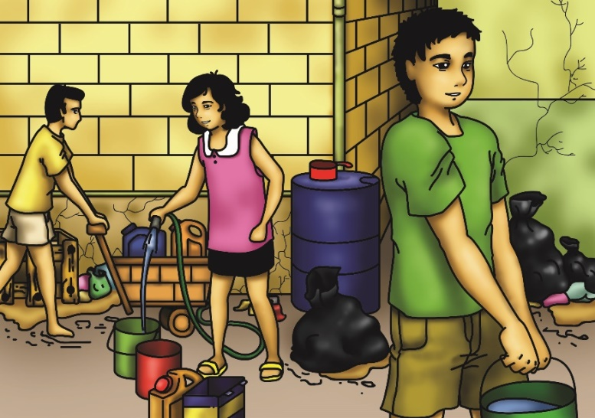
Project photos and any additional conclusions?
Federation WASH

Slide 24
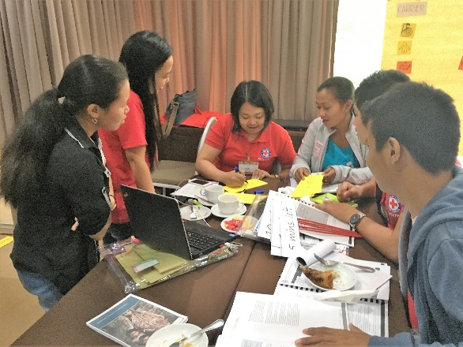
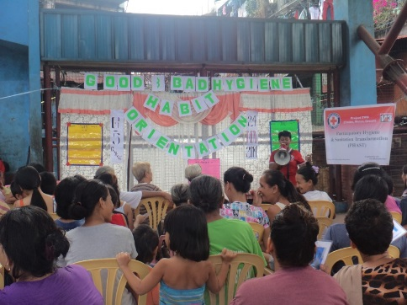
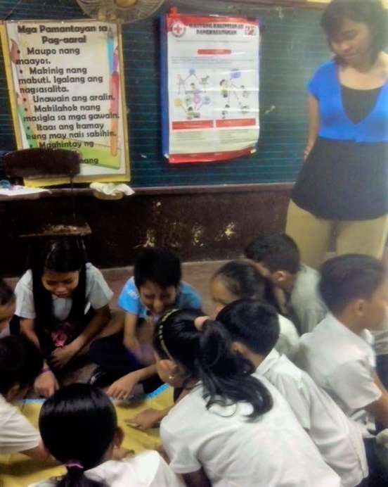
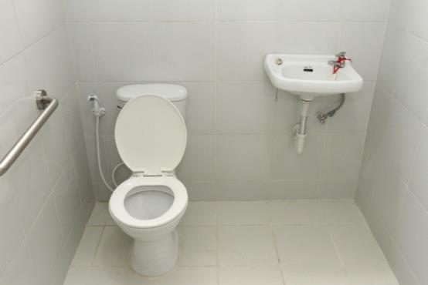
Project photos and any additional conclusions?
Federation WASH

