Slide 1
Urban WASH Technical Working Group Nairobi, September 2017 Standard PP for Case Studies. Note: Detailed information or reports should be sent to R. Fraser to be uploaded onto the wiki site before the meeting. This template is for you to summarise and present your project during the meeting.
Federation WASH
National Society(s) active in this Project: Bangladesh Red Crescent Society
Country/Location of Project: Barisal City Corporation, Bangladesh
Title of Project/Case Study: Barisal Urban V2R Project
Time scale of project: Oct 2015- Sept 2018
Approximate Total Budget (USD): 1.25 m
Target population: 23,879 people
WHERE WE WORK

Slide 2
Urban WASH Technical Working Group Nairobi, September 2017 Standard PP for Case Studies
Federation WASH
What the project delivers in water supply: Deep tube-wells (water points, depth 350 meters appx.).
What the project delivers in sanitation: Communal bathroom and latrines (separate for male and female), drainage with lid using as sidewalk in the community. Plan to construct school WASH block.
What the project delivers in Hygiene: Clean-up campaign, awareness sessions, IEC materials, trash basket for households, communal dustbin, three wheeler to collect garbage from the community etc.
Capacity building of target population: Community Disaster Management Committee (CDMC), Community Disaster Response Team (CDRT), Water User Group {(WUG) WASH volunteers, caretaker group training}, training for women on safe motherhood, courtyard sessions. School brigade as change agent, training of teachers etc.
Capacity building of WASH service providers: Formation of City and Ward WATSAN committee, coordination with Barisal City Corporation through linkage workshop, regular dialogue and engaging service provider as trainer etc.

Slide 3
Urban WASH Technical Working Group Nairobi, September 2017 Standard PP for Case Studies
Federation WASH
Describe Achievements and lessons learned, what worked well?
Improved water and sanitation facilities, improved knowledge base
Continuous liaison with service provider to ensure service
Effective community mobilization, reduced water logging
BDRCS staff and volunteers received training on WASH
CDMC evolved as community leader
Describe challenges, what did not go so well?
Depletion of underground water level
Installation of illegal submersible pumps
Lack of capacity of supervision and maintenance of water point and latrines by Barisal City Corporation
What resources did you need or lack?
Shortage of human resources in BCC in terms of supervision and maintenance of communal infrastructures

Slide 4
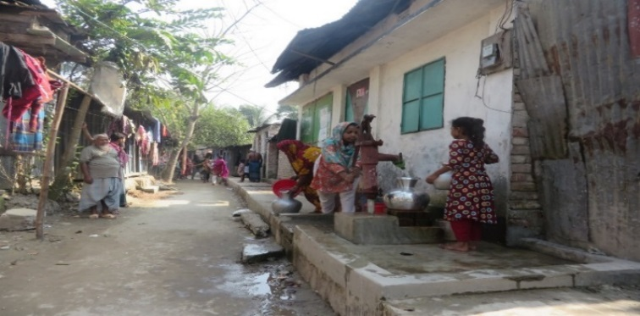
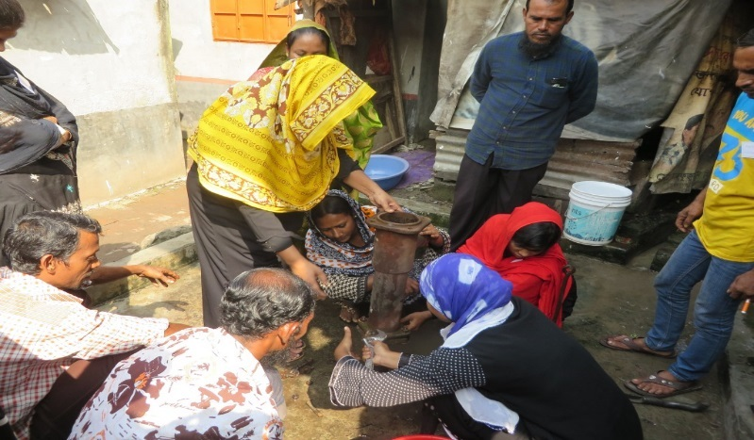
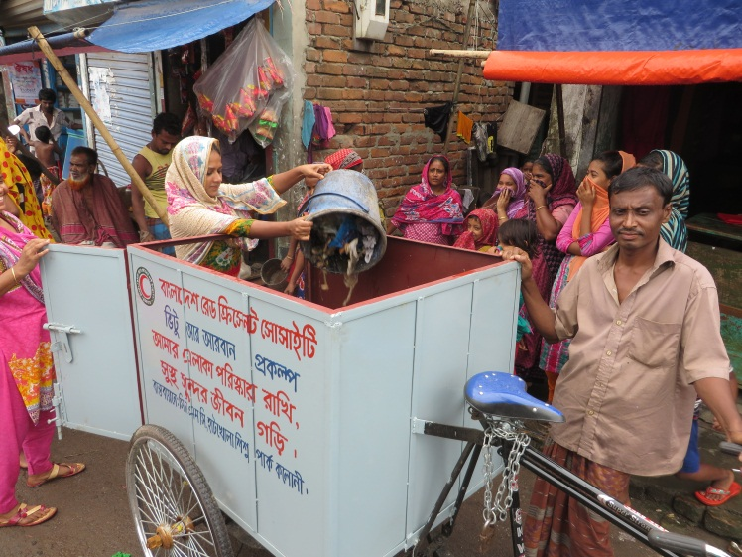
Project photos
Federation WASH
Drainage construction by V2R project
Water logging before V2R project
Tube-well maintenance V2R project
Support for waste removal by V2R project

Slide 5
Urban WASH Technical Working Group Nairobi, September 2017 Standard PP for Case Studies
Federation WASH
Conclusion
Half of the population of Bangladesh will live in urban areas by 2030.
More efforts will be required to address the growing needs regarding water and sanitation of low income communities living in urban areas in Bangladesh
Utilizing the status of BDRCS as an auxiliary organization of the government in urban programming.
Empowering local community, inclusion to local government bodies and functional linkage with the local government to ensure services even after the project

