Slide 1
Urban WASH Technical Working Group Nairobi, September 2017 Standard PP for Case Studies. Note: Detailed information or reports should be sent to R. Fraser to be uploaded onto the wiki site before the meeting. This template is for you to summarise and present your project during the meeting.
Federation WASH
National Society(s) active in this Project-: The Malawi Red Cross Society with technical support from the Netherlands Red Cross
Country/Location of Project: Malawi in Mzuzu and Karonga city and town councils respectively
Title of Project/Case Study: Integrated WASH intervention in low income areas ( LIA)
Time scale of project: 34 Months
Approximate Total Budget (Euros): 1.7 Million
Target population:45,000 Low Income Communities
WHERE WE WORK

Slide 2
Urban WASH Technical Working Group Nairobi, September 2017 Standard PP for Case Studies.
Federation WASH
Describe what the project delivers in water supply:
25 Water Kiosks rehabilitated and functional
20 New Water Kiosks constructed and functional
58 private connections with an extended pipe network reaching out to 348
2 Water Users Associations Established in Mzuzu and Karonga and trained in the management of the water points.
45 water kiosk holders/committees formed and trained in operation and maintenance of the water kiosks.
Describe what the project delivers in sanitation:
15 Public cubicle latrines constructed in two market places.
85 Cubicle latrines with urinals constructed in 20 schools
Appropriate Latrine Designs produced for schools and market places.
Four demonstration latrines such as skyloo, Fossatena, improved traditional latrines and VIPs were constructed for communities to adapt.
Two sludge ponds and one solid waste facility rehabilitated and functional
585 institutional latrines emptied (desludged) and repaired.

Slide 3
Continued
Describe what the project delivers in Hygiene:
Constructed 26 handwashing facilities in schools and market places.
Reached out to 45,000 direct beneficiaries and over 70,000 indirect beneficiaries with good hygiene promotion messages through hygiene promotion campaign activities, films, radio slots, etc
The project contributed to reduction of cholera cases in Karonga. Out of 232 cases registered, only 5 cases were registered in the urban areas of Karonga
Communication strategy was developed

Slide 4
Continued
Describe capacity building of target population:
2 Water Users Associations were trained and functional
School based management committees trained in the management and control of building materials and the builders.
45 Water kiosk committees trained in the operation and maintenance of the water kiosks.
20 school sanitation/ hygiene clubs/volunteers trained in Urban hygiene and sanitation services.
50 volunteer masons were trained in sanitation marketing

Slide 5
Continued
Describe capacity building of WASH service providers:
MRCS staff and NLRC delegate attended a three day Grants Management workshop at the EU Delegation on implementation and finance management.
145 volunteers and extension workers were trained in CLTS.

Slide 6
Continued
Sanitation and care taker management committees in schools and markets were trained in the supervision of construction works and material storage ,tracking and use.
Two volunteers were trained in the operation and simple maintenance of the mobile desludging unit (MDU) by the private company.
20 Local entrepreneurs including the two MDU operators were identified and trained in waste management business.

Slide 7
Urban WASH Technical Working Group Nairobi, September 2017 Standard PP for Case Studies.
Federation WASH
Describe Achievements and lessons learned, what worked well?
Over 12, 852 urban poor have access to safe drinking water.
Desludging, repair and construction of latrines further assisted the two urban areas in proper management of waste.
The project strengthened relationship between the National Society and her partners including Councils, Northern Region Water Board, Mzuzu University, WES Management and the community.
Registered reduced cholera cases in the project areas with none in Mzuzu and only 5 cases out of 232 cases in Karonga district.

Slide 8
What resources did you need or lack
More financial resources were required to tackle some of the unattended problems like expansion of pipe network to cater for the other members, construction of other waste management facilities.
Additional expertise in areas of solid waste management (construction of dumpsite facility) was needed at council level Karonga) to monitor and manage contractors effectively.
Complete set of Mobile Desludging Unit (MDU), i.e. ROM, 3 tonne Vehicle, etc. to cater for the two urban areas.

Slide 9
Describe challenges, what did not go so well
Limited resources compared to the existing problems in the peri-urban settlements.
Managing and working with several partners especially the private sector and research institutions was not easy due to differences in approach (socio vs economic sectors).
Many household latrines collapsed due to heavy rains after a lot of efforts including finances were put in. It required additional resources to regain our achievements lost
.

Slide 10
Challenges continues
Sometimes it was difficult to conduct hygiene promotion campaigns during the day because many people were out doing businesses as a result we were forced to conduct such campaigns at night

Slide 11
Continued
MRCS needed more expertise in communication, hence the project engaged a consultant to help come up with communication strategy befitting the lifestyles for the urban people.
MRCS needed expertise to desludge latrines for completion of sanitation chain and sustained use of latrines, that is why a private sector with MDU expertise was required and engaged

Slide 12
Continued
MRCS needed advanced expertise to properly supervise and guide construction works of the modern waste facilities constructed in Mzuzu and Karonga, however government and NLRC through their engineers came to our rescue to supervise and provide guidance on how best the facilities could be constructed.

Slide 13
Continued
Working with private sectors & research institutions helps to sustain and improve implementation of WASH intervention.

Slide 14
Mobile Desludging Unit
Pit latrines and in particular ventilated improved pit latrines (VIPs) are the most basic form of improved (acceptable) sanitation. However when the pit becomes full the facilities are no longer functional.

Slide 15
BACK GROUND OF MOBILE DESLUDGING UNIT - MDU
With increasing Global interest in the management of faecal sludge in un sewered areas, increasing effort is being placed on the development of equipment that can effectively, efficiently and safely empty and transport sludge from toilets such as all types pit latrines as well as infiltration pits (though commonly described as septic tanks) in some case.

Slide 16
Cont
Options include reverting to open defecation, abandoning the facility and building a new one or emptying the pit and safely disposing of the contents.

Slide 17
DEVELOPMENT OF MDU
A Mobile Desludging Unit (MDU) has been developed and tested in Malawi.
Developed through both the Innovative and imitative theories
Local and International partners involvement
Higher learning institutions involvement

Slide 18
THE MDU

Slide 19
The MDU at work

Slide 20
Desludging Team

Slide 21
Why MDU
The MDU has proved to be capable of emptying almost any sludge; it is reliable, fast, safe and economical to operate.
Clients include households from high, medium density locations, schools, local authorities, and NGOs.
The "principle of factor sparsity" and the "law of the vital few.“
The 80/20 Rule

Slide 22
How it works
The equipment is designed for “difficult sludge” and difficult access areas
The sludge which is semi solid and hard to remove: ie thick sludge with more than 15% solids and mixed with rubbish;
The toilet facility which is hard to access: narrow lanes, bumpy roads, steep slopes, muddy roads, obstacles such as other buildings, trees, fences, etc.;

Slide 23
Desludging Process- Fluidization

Slide 24
Use of High Pressure
The idea of using a high pressure washer is based on using one of the properties of sludge called thixotropy:
“Thixotropy is the property of certain gels or fluids that are thick (viscous) under normal conditions, but flow (become thin, less viscous) over time when shaken, agitated, or otherwise stressed”.

Slide 25
Fluidization of Abandoned Latrines

Slide 26
Why Fishing
The remedy to this is to “fish” out the rubbish. The fishing operation often required that the
hard sludge be softened or fluidized. In any case the hard sludge is too solid to be pumped out, and requires “fluidizing”.
This is traditionally done by adding large amounts of water to the pit sludge and stirring with a stick.

Slide 27
Fishing

Slide 28
Non Sludge in Sludge

Slide 29
Cont’

Slide 30
The Sludge

Slide 31
Pumping

Slide 32
Transportation

Slide 33
Disposal

Slide 34
Challenges
People use pit latrines as rubbish pits hence throw in a lot of non feacal material
Pit latrines are also used as secret places where non palatable materials are deposited
Poor Latrines structures
Late funding

Slide 35
Conclusion
Desludging of pit latrines is economical
Desludging brings continued development
Desludging is a means of appreciating the past investments
Desludging is the way to go

Slide 36
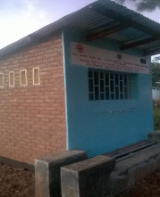
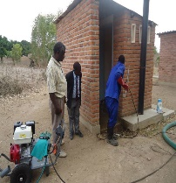
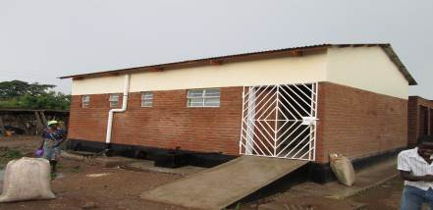
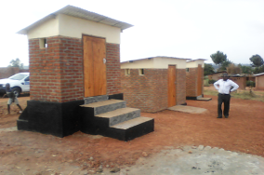
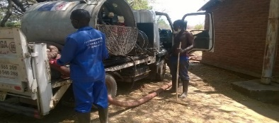
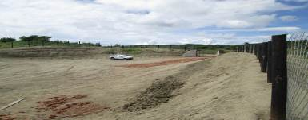
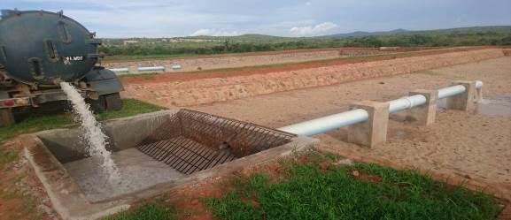
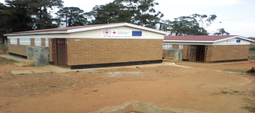
Project photos and any additional conclusions
Federation WASH
The urban poor are largely ignored in terms of service provision by the city authorities in most of the developing countries. Budgetary support is low.
Below are some of the structures constructed, refer to the main report attached. From left on top are: desludged latrine, market paid toilet, demonstration latrine water kiosk. Below from left MDU unit, dumpsite, sludge pond and VIP latrine

Slide 37
Coming together is a beginning, keeping together is progress

